Slide 2
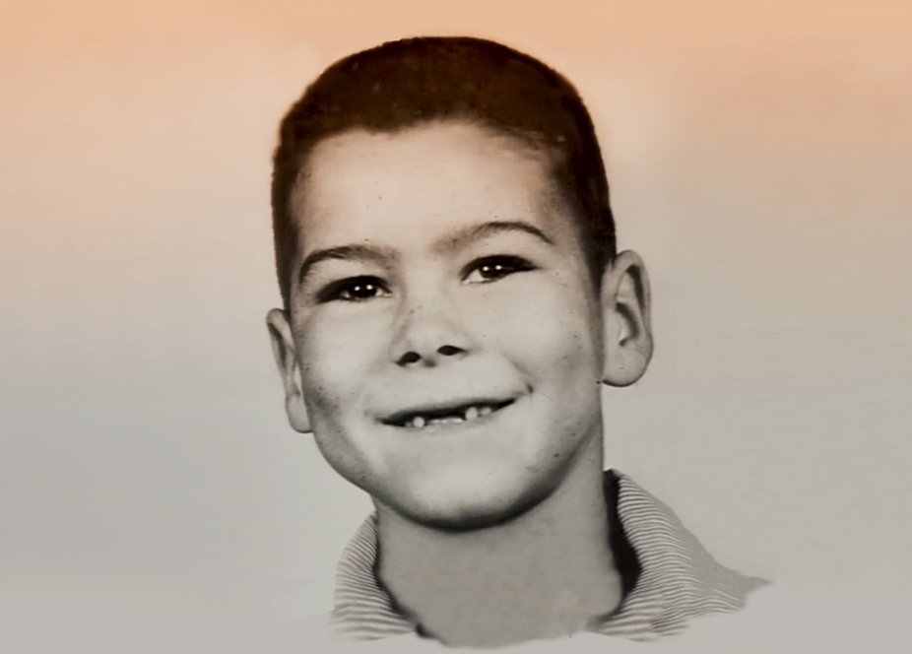
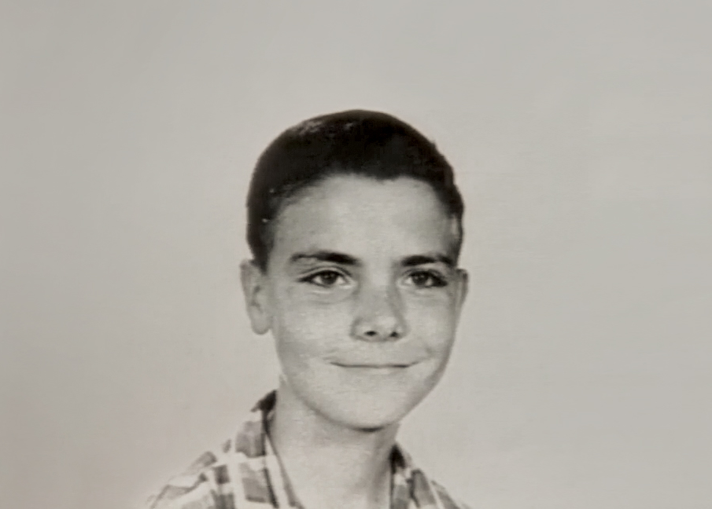
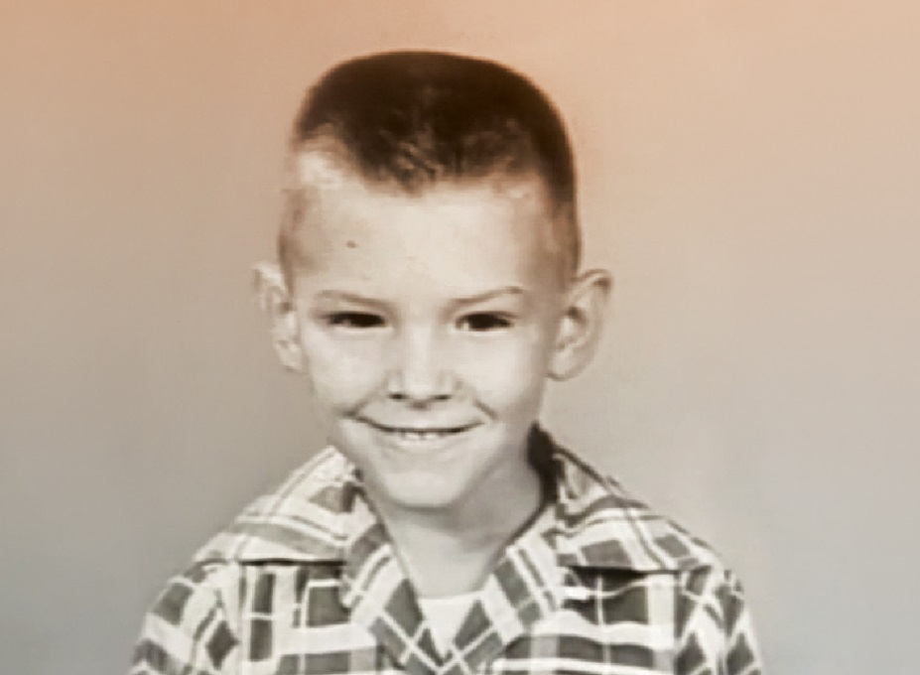
The three cousins who formed Alabama in 1968.
Randy Owen
Teddy Gentry
Jeff Cook

Slide 3
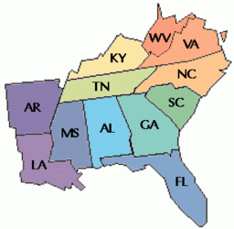
Raised near Lookout Mountain, AL, the group performed in Myrtle Beach, SC for several years before they found success in Nashville, TN.

Slide 4
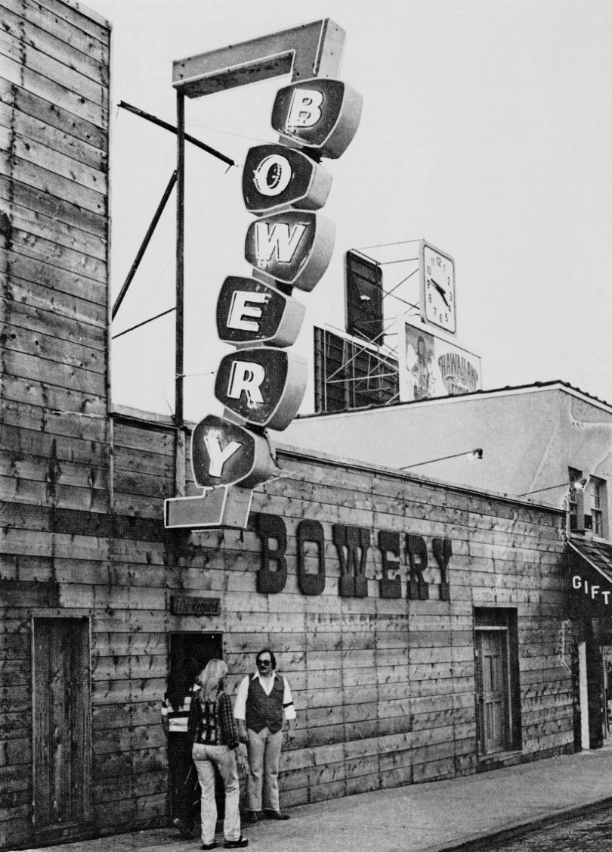
Alabama performed at The Bowery in Myrtle Beach, South Carolina for seven seasons. There they honed their craft and learned that country music could appeal to any music lover if played with enough energy.

Slide 5
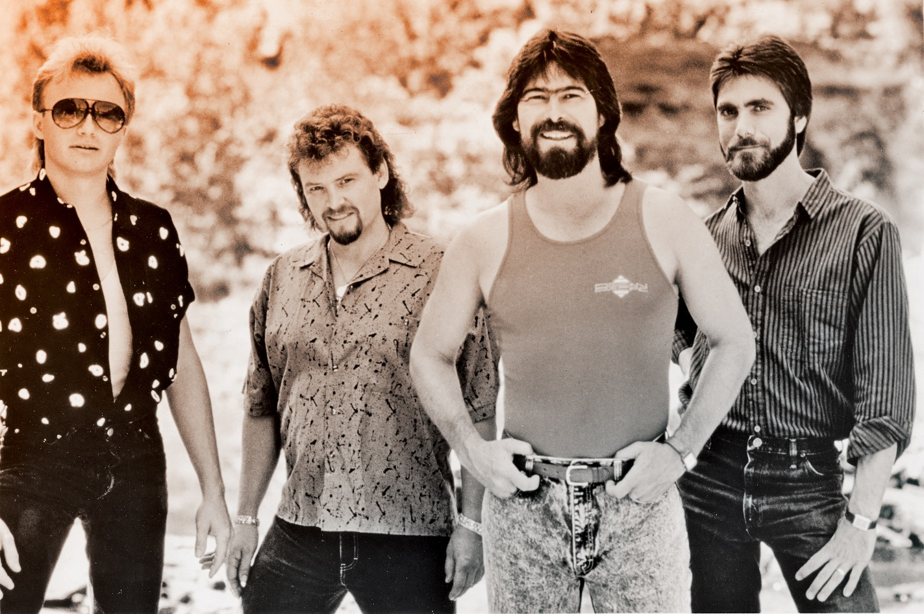
From left to right-
Mark Herndon, Jeff Cook, Randy Owen,
and Teddy Gentry.

Slide 8
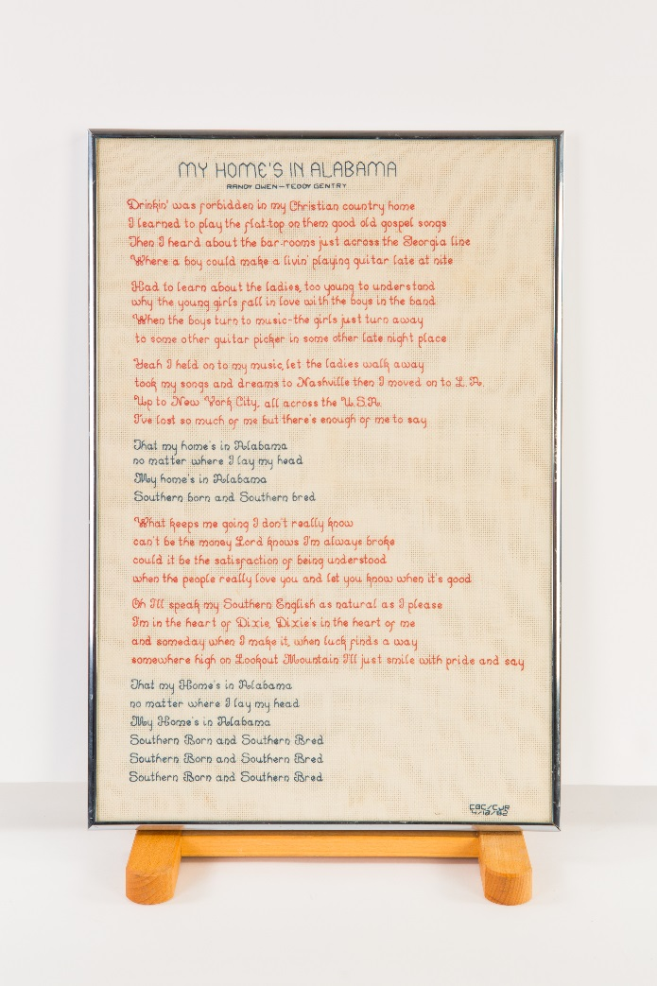
The Alabama boys never forgot their Southern roots and always paid homage to their home state. Here, the lyrics to “My Home’s in Alabama” by Randy Owen and Teddy Gentry are stitched as a poem.

Slide 9
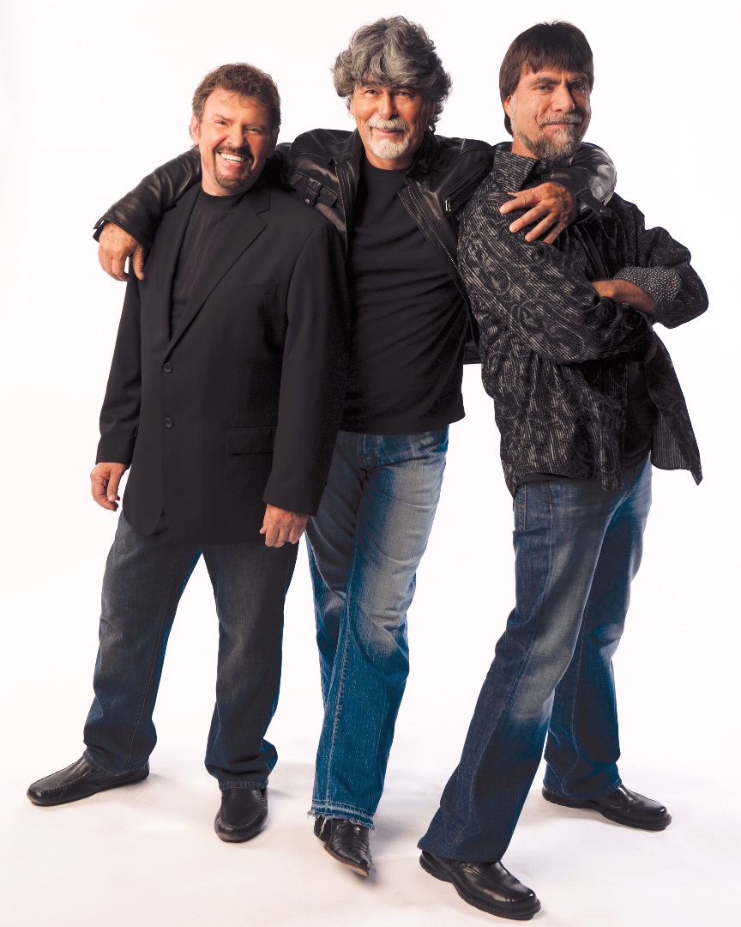
Family members Jeff Cook, Randy Owens and Teddy Gentry remain the foundation of one of the most influential country bands of all time.

