Slide 2
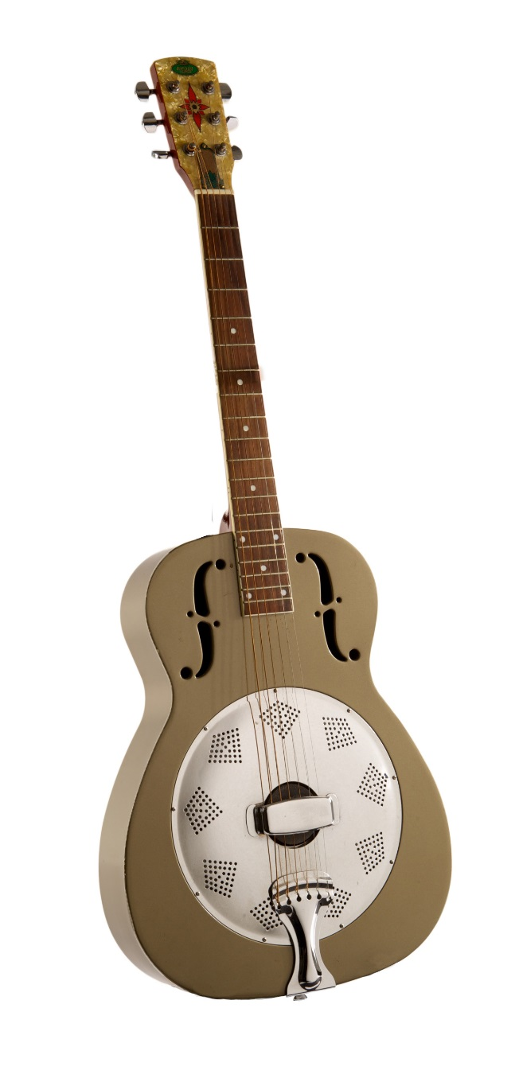
Neil Young presented this metal body Regal Dobro to Ben Keith after one of Keith’s most treasured guitars was stolen.
Courtesy of Heidi Denning/Photo by Bob Delevante

Slide 3
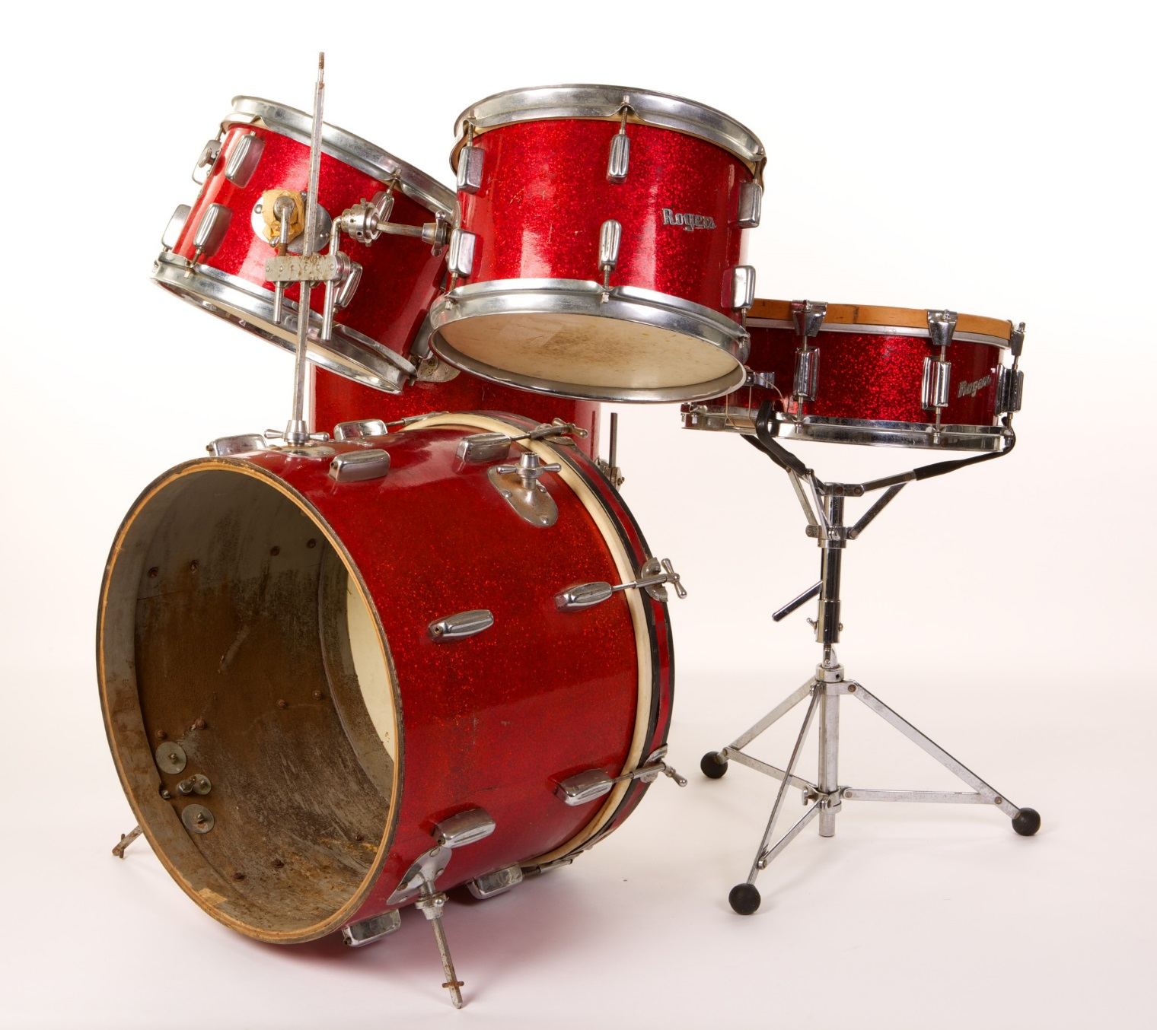
Rogers Drum Kit Used by Kenny Buttrey
Courtesy of
Cheri Buttrey-Jenkins/Photo by Bob Delevante

Slide 4
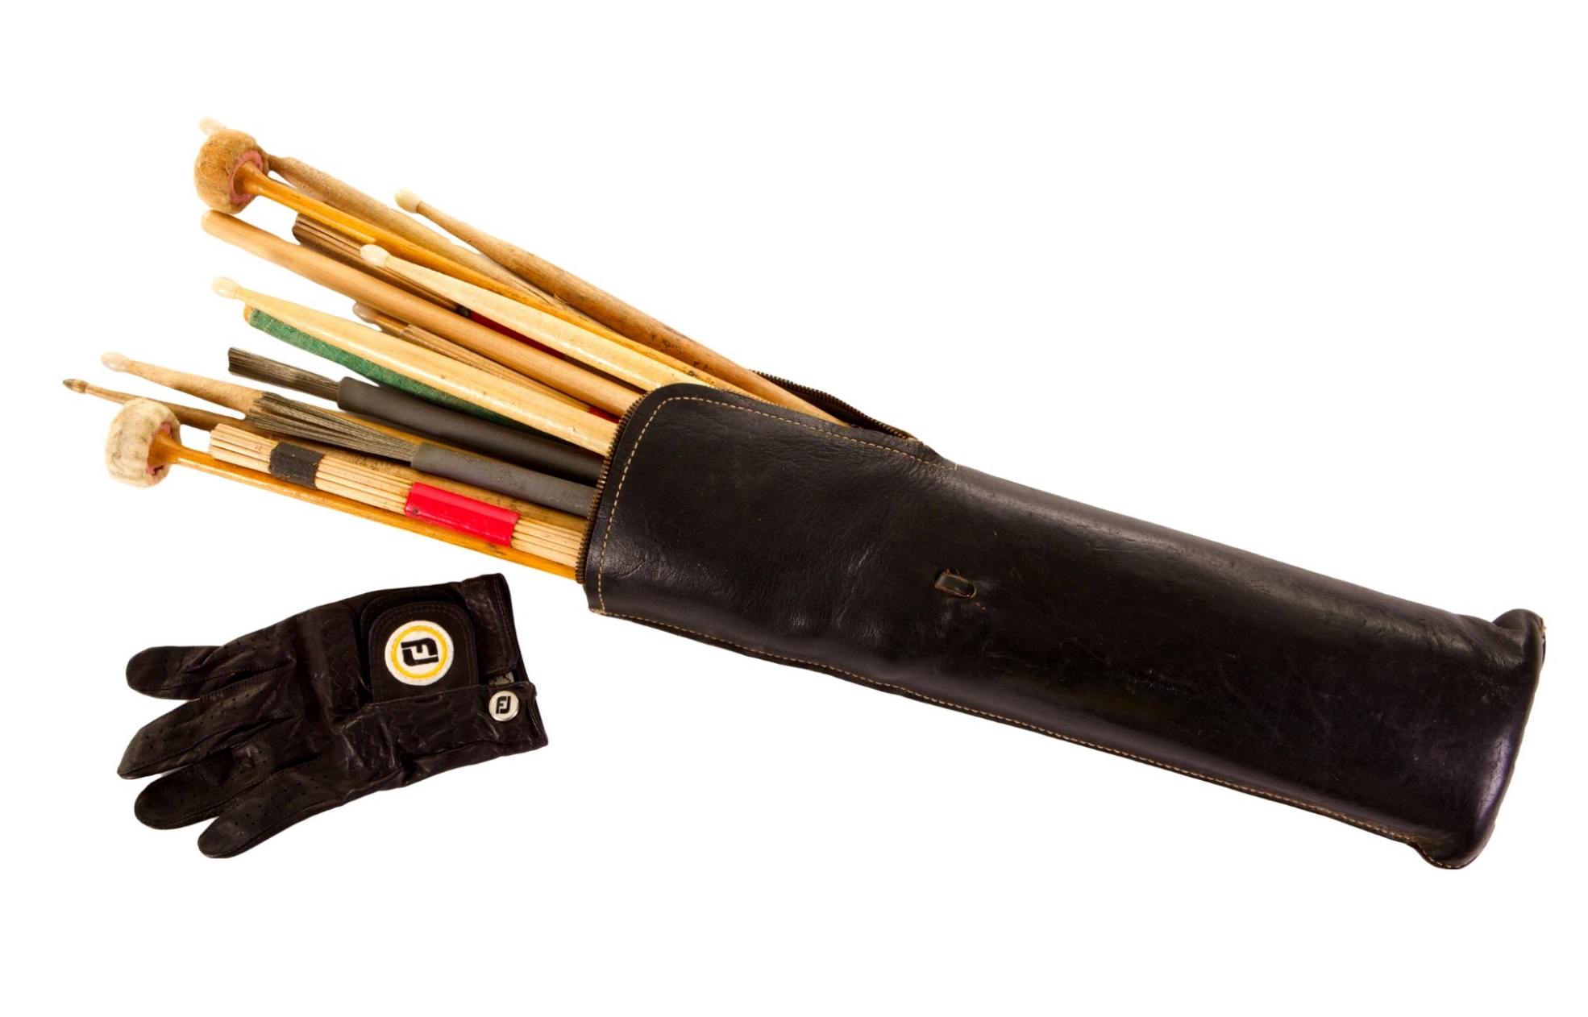
Kenny Buttrey’s drum sticks

Slide 5
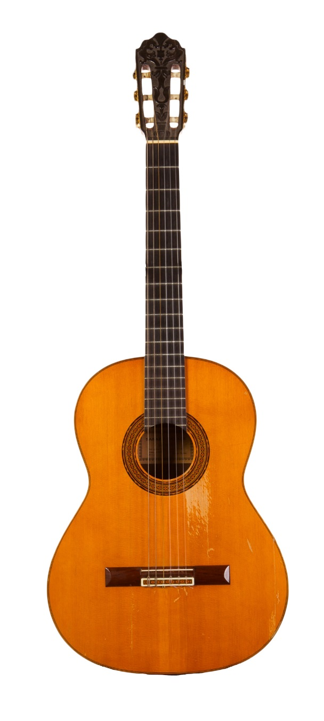
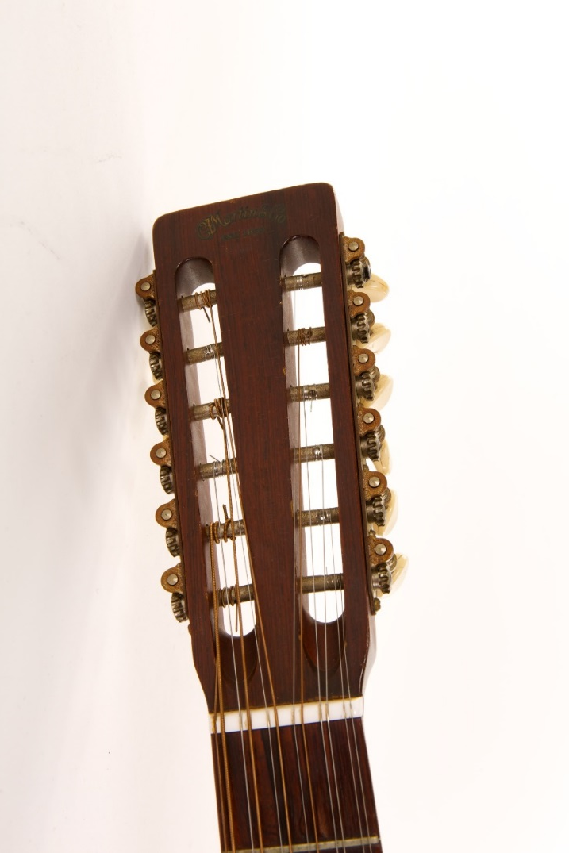
Headstock of Fred Carter Jr.’s 1966 Martin D12-20.
Courtesy of the Family of Fred Carter Jr./Photo by Bob Delevante
Fred Carter Jr.’s 1967 Sakazo Nakade Nylon-String Guitar.
Courtesy of the Family of Fred Carter Jr.

Slide 6
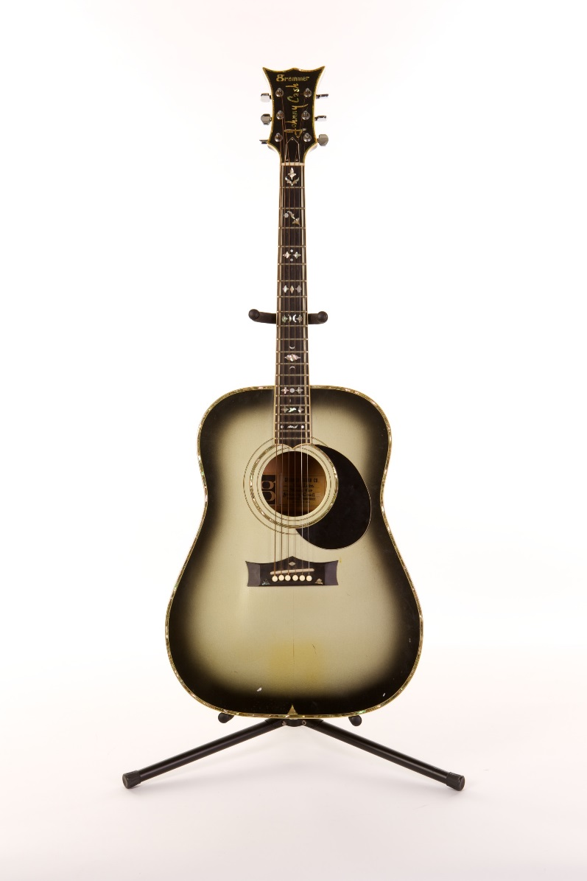
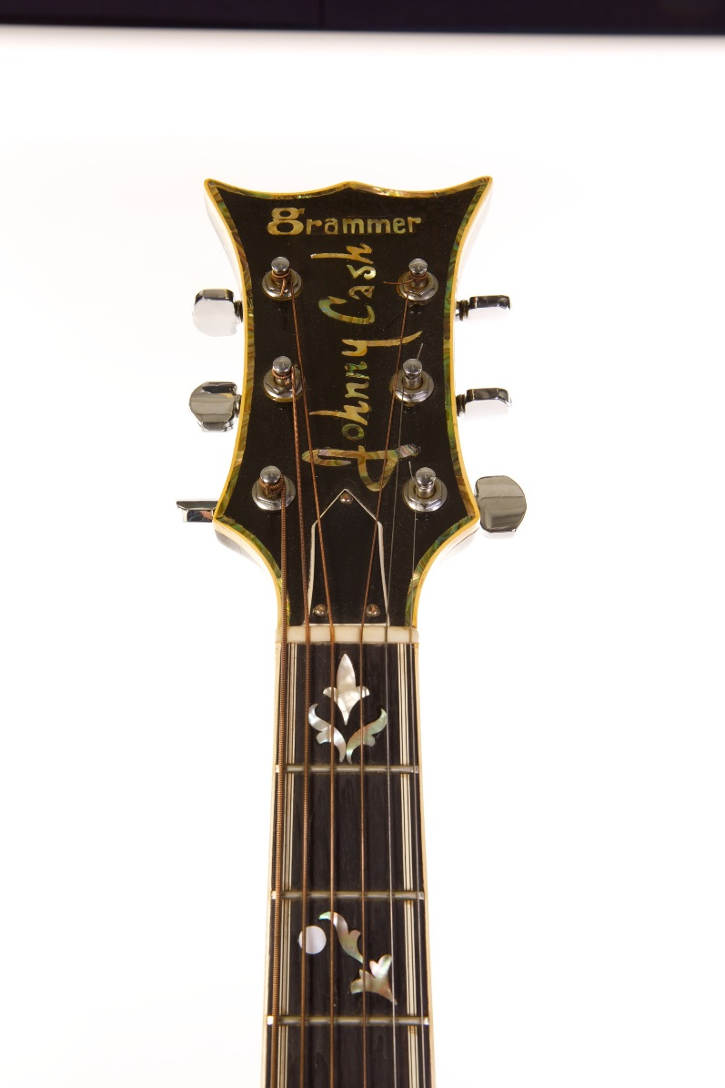
Johnny Cash used this custom-made guitar on his TV show.
Courtesy of Marty Stuart/Photos by Bob Delevante

Slide 7
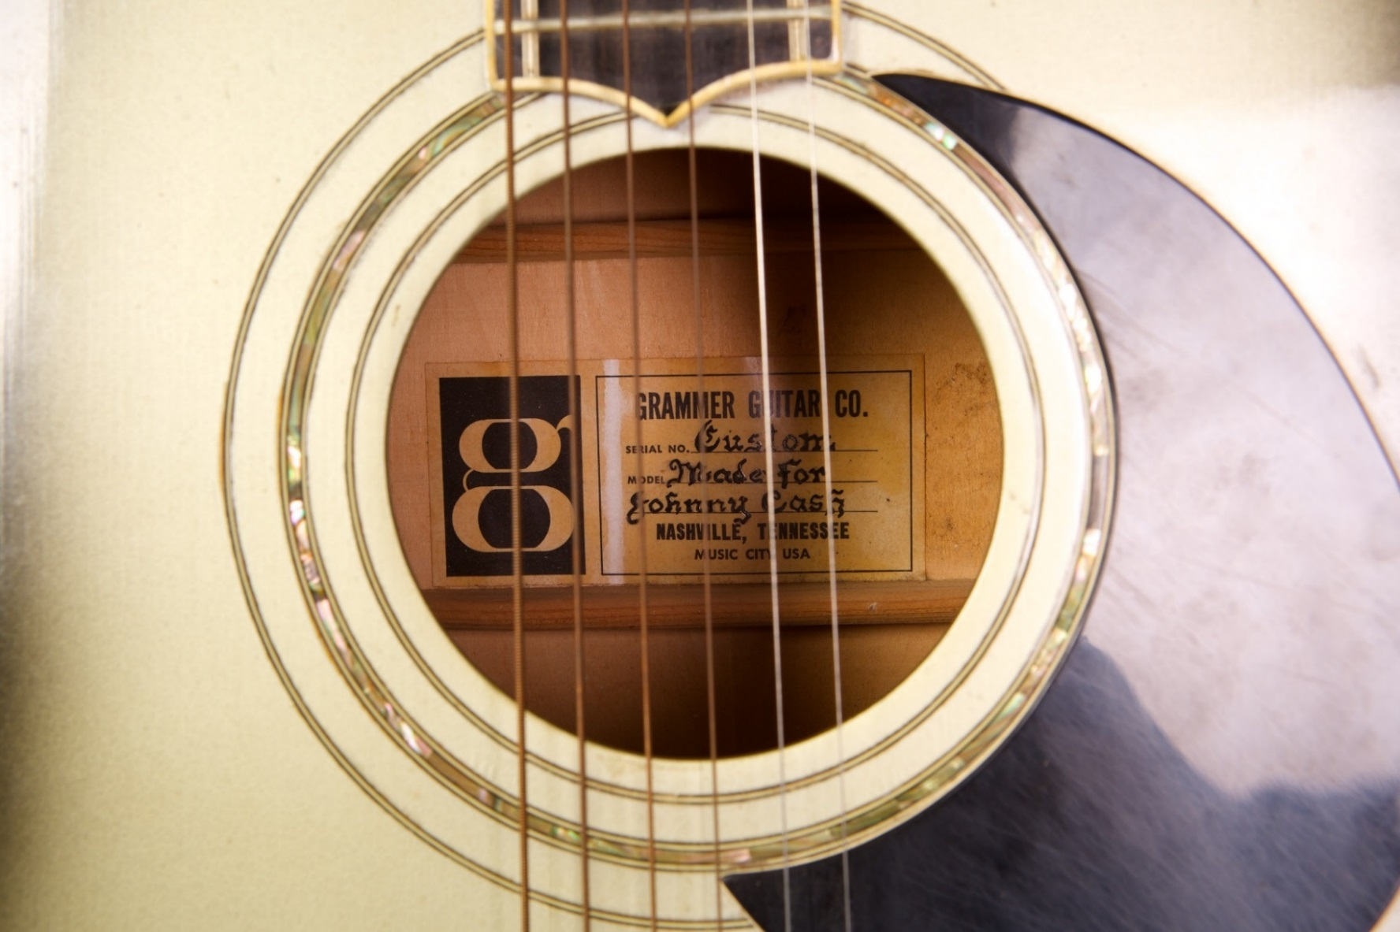
Johnny Cash used this custom-made guitar on his TV show.
Courtesy of Marty Stuart/Photos by Bob Delevante

Slide 8
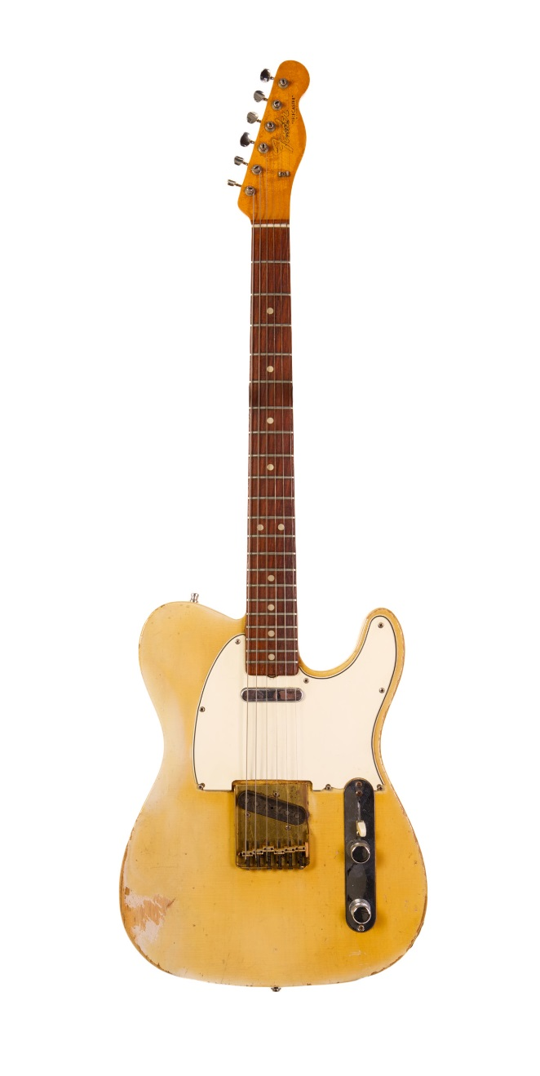
Charlie Daniels used this mid-1950s Fender Telecaster on sessions for Nashville Skyline and Self Portrait.
Courtesy of Charlie Daniels/Photo by Bob Delevante

Slide 9
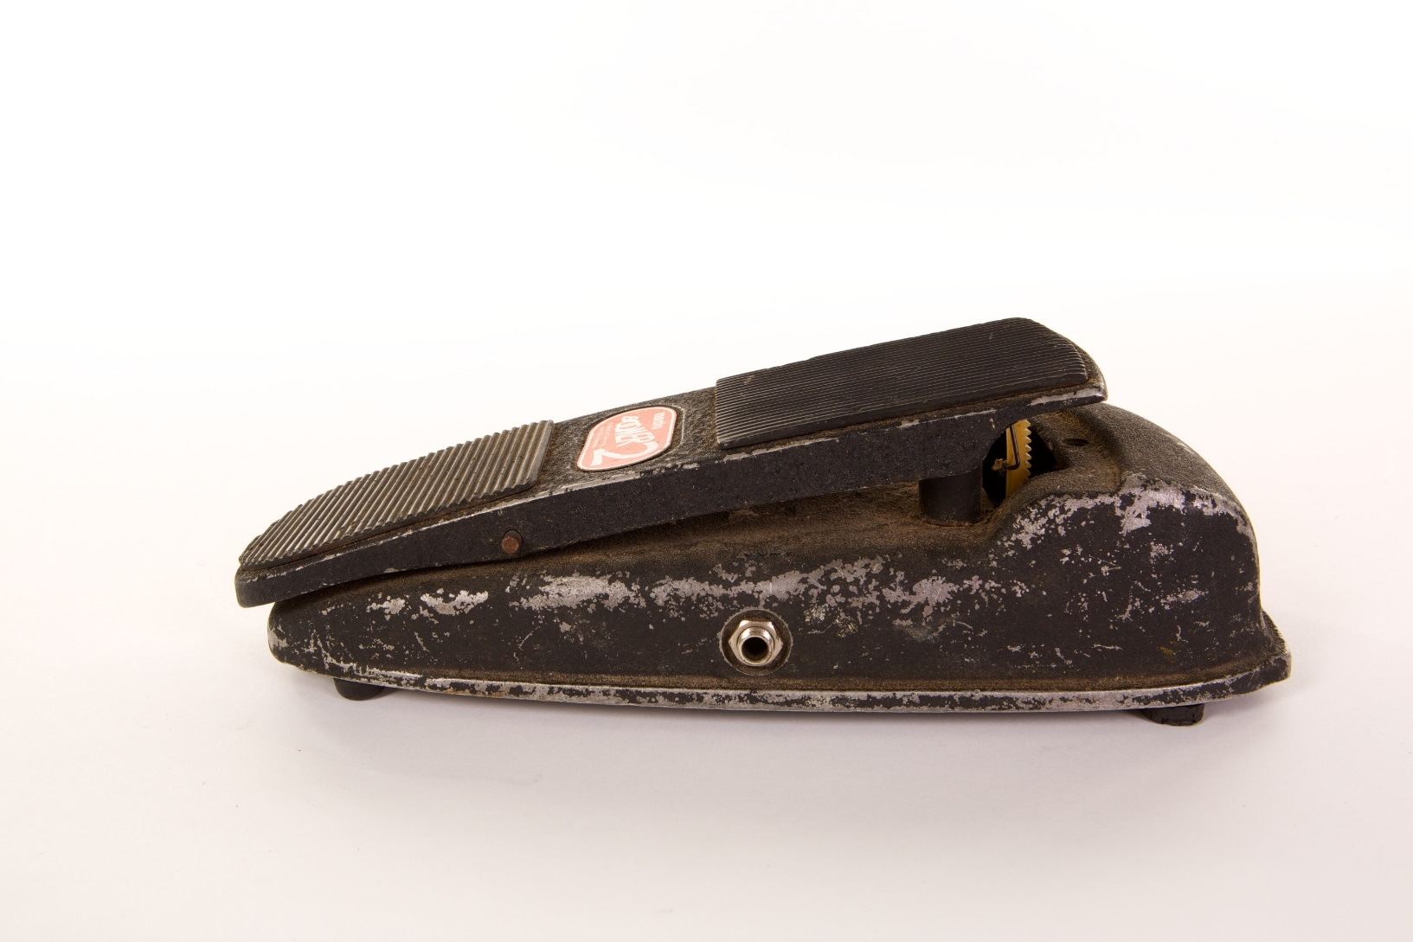
Mac Gayden used this Gibson Maestro Boomer 2 Wah-Wah pedal to create distinctive guitar licks on J.J. Cale’s “Crazy Mama.”
Courtesy of Mac Gayden/Photo by Bob Delevante

Slide 10
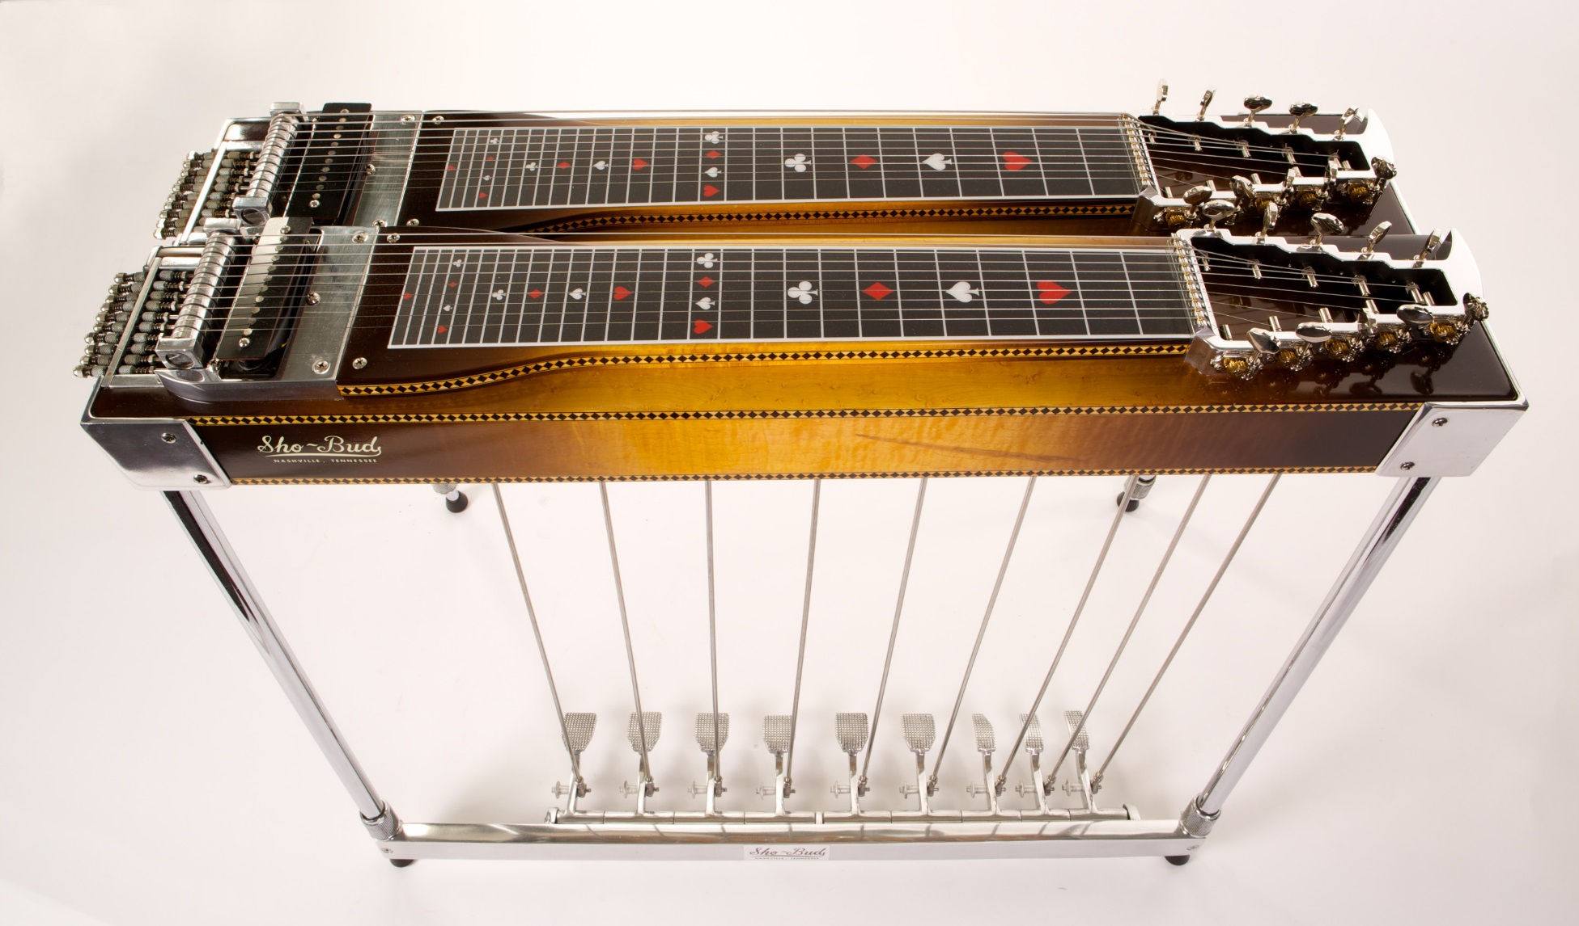
Lloyd Green’s 1967 Sho-Bud Fingertip Pedal Steel guitar.
Courtesy of Gary Boyd/Photo by Bob Delevante

Slide 11
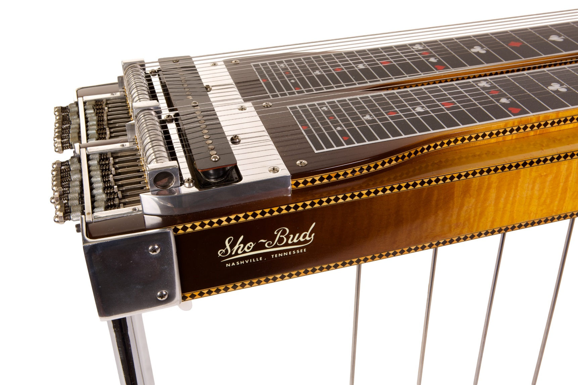
Lloyd Green’s Pedal Steel guitar.
Courtesy of Gary Boyd/Photo by Bob Delevante

Slide 12
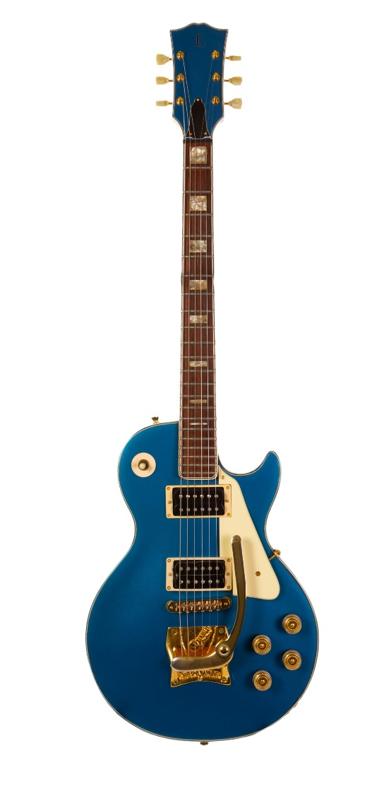
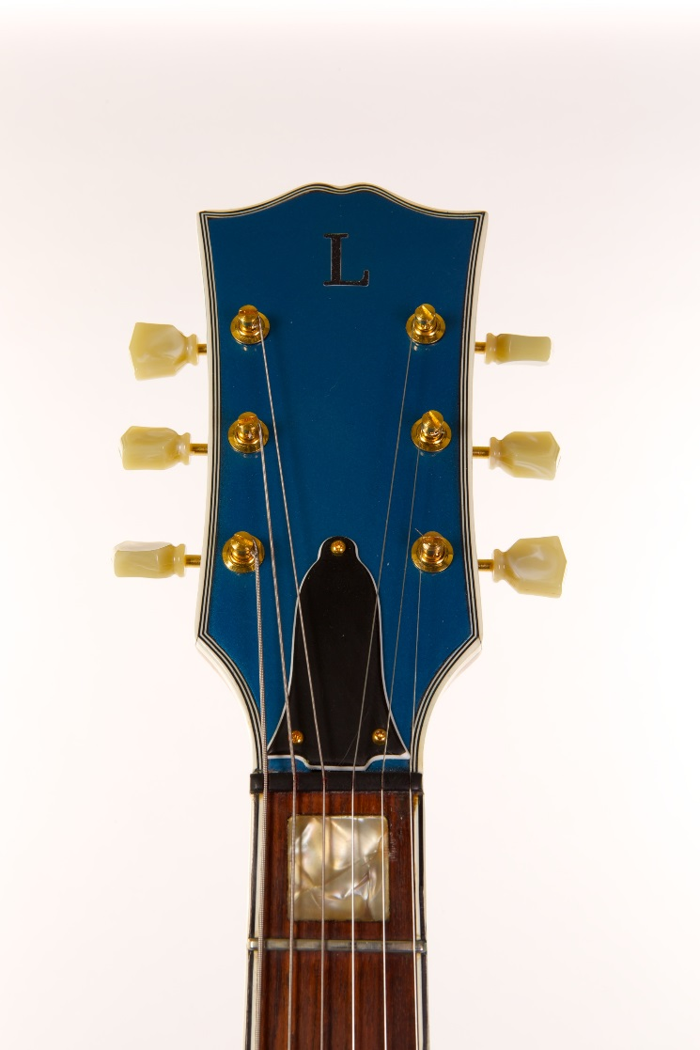
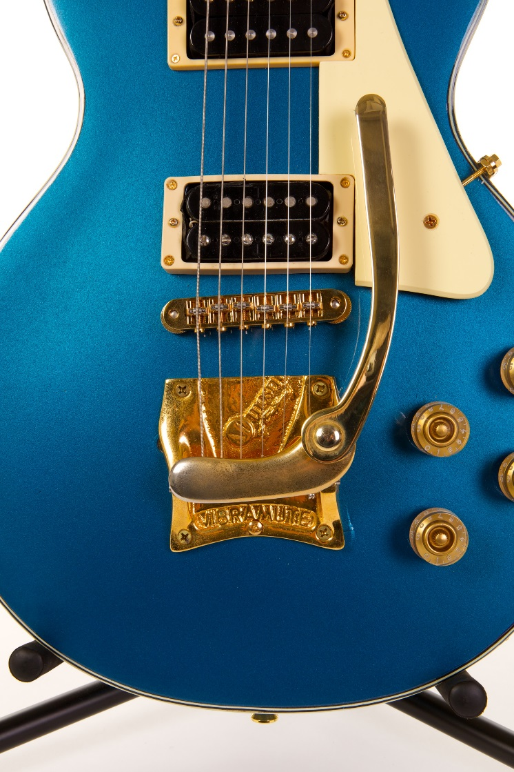
Mac Gayden used this Lincoln Electric Guitar and a Gibson Maestro Boomer 2 Wah-Wah pedal to create the distinctive slide guitar licks on J.J. Cale’s 1972 Hit “Crazy Mama.”
Courtesy of Mac Gayden/Photo by Bob Delevante

Slide 13
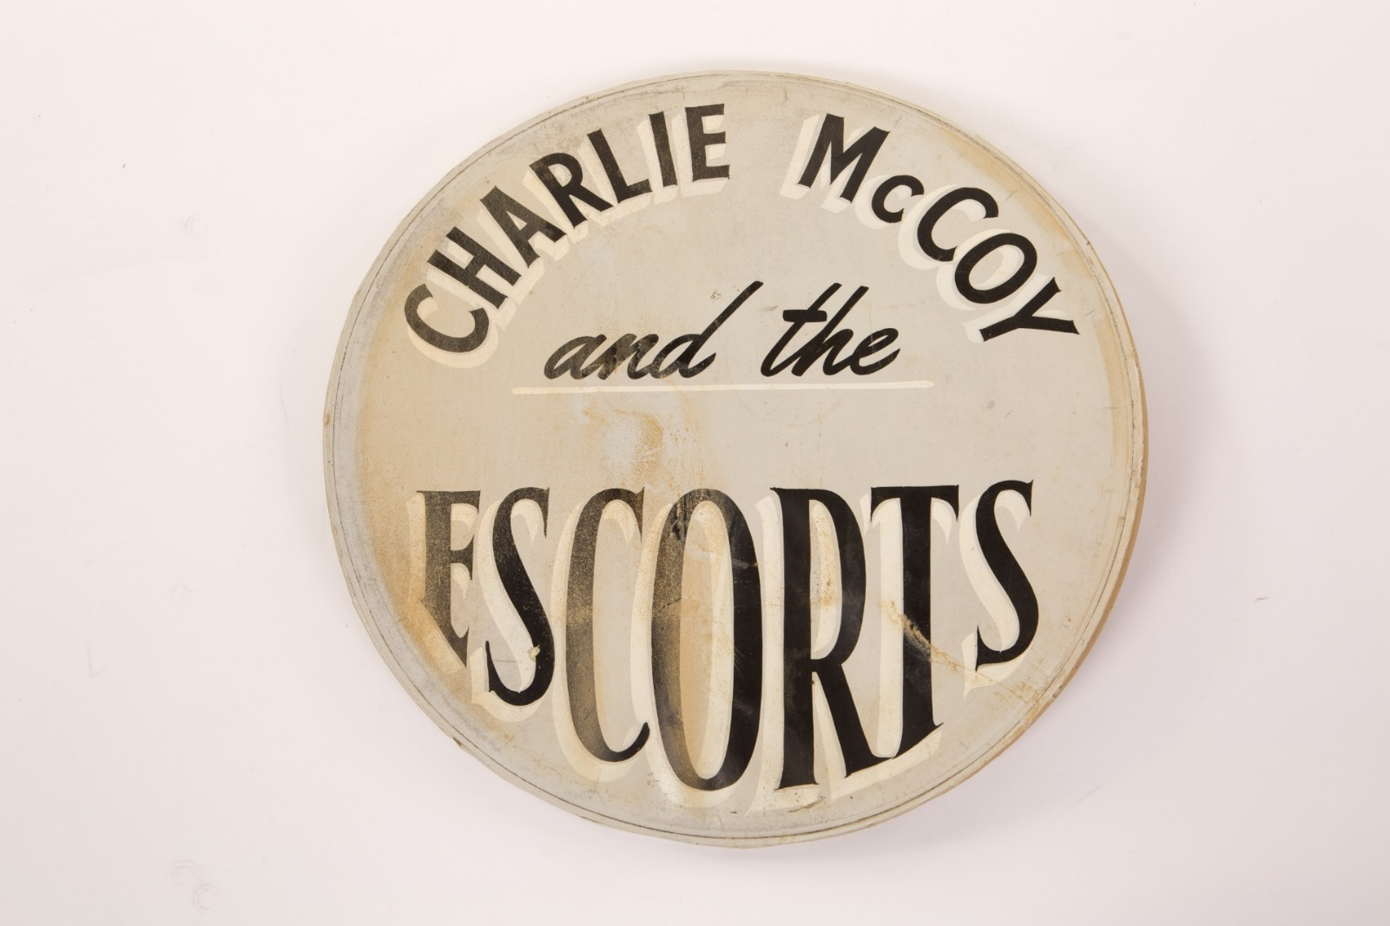
Hand-painted bass drum head used on Kenny Buttrey’s drum kit when he performed with Charlie McCoy and the Escorts in the 1960s.
Courtesy of Cheri Buttrey-Jenkins/Photo by Bob Delevante

Slide 14
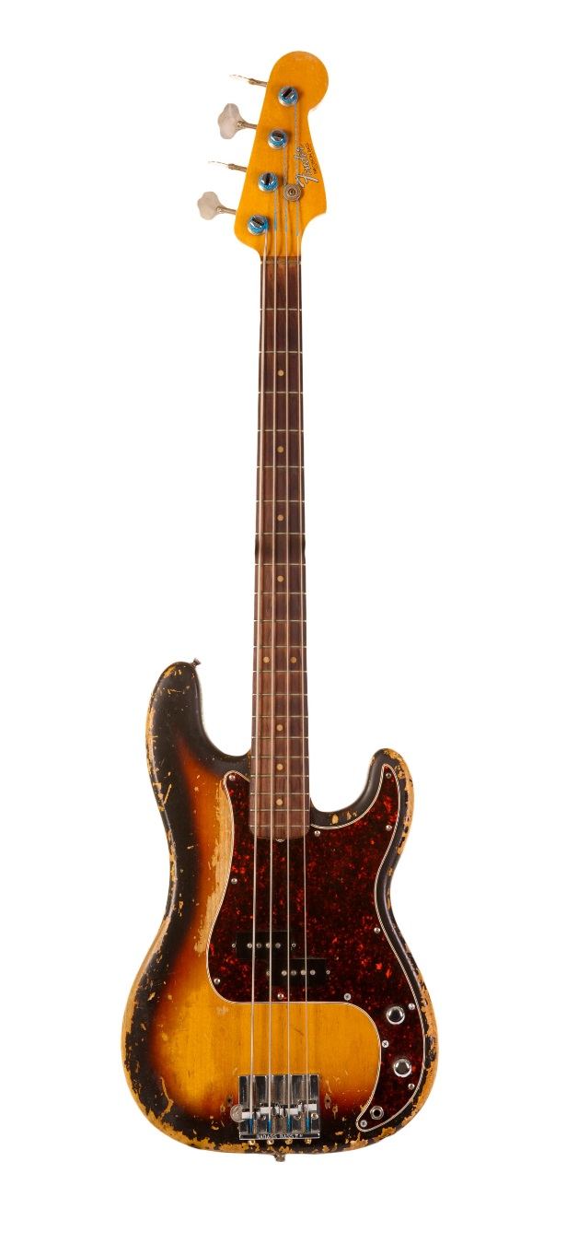
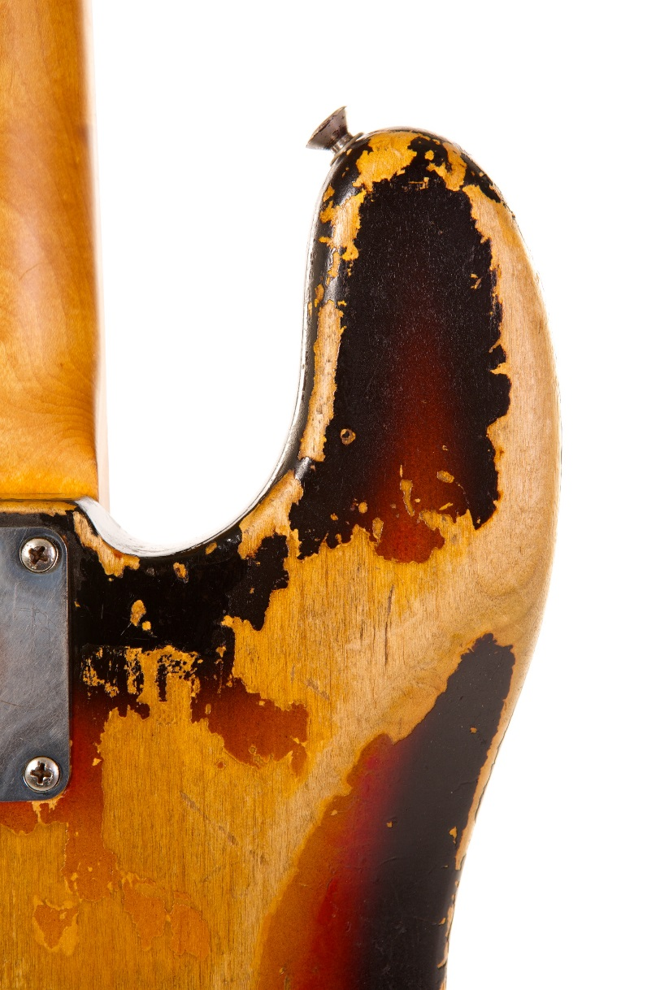
Norbert Putnam played this 1965 Fender Precision Bass on hundreds of recordings including releases by Joan Baez, Elvis Presley, Linda Ronstadt, and Tony Joe White.
Courtesy of Norbert Putnam/Photo by Bob Delevante

Slide 15
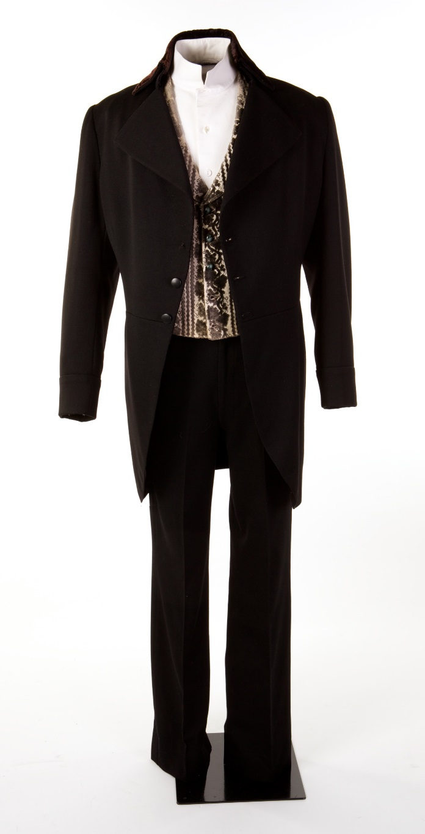
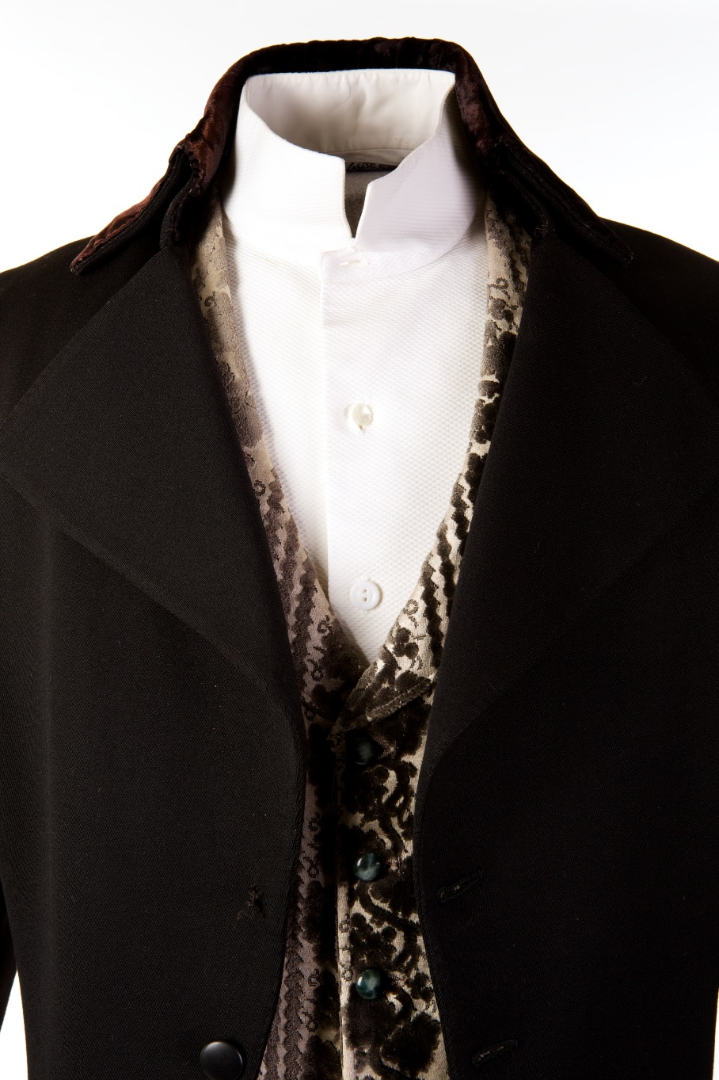
Cash wore this Eaves Costume Company Suit on his network TV show.
Courtesy of Marty Stuart/Photo by Bob Delevante

Slide 16
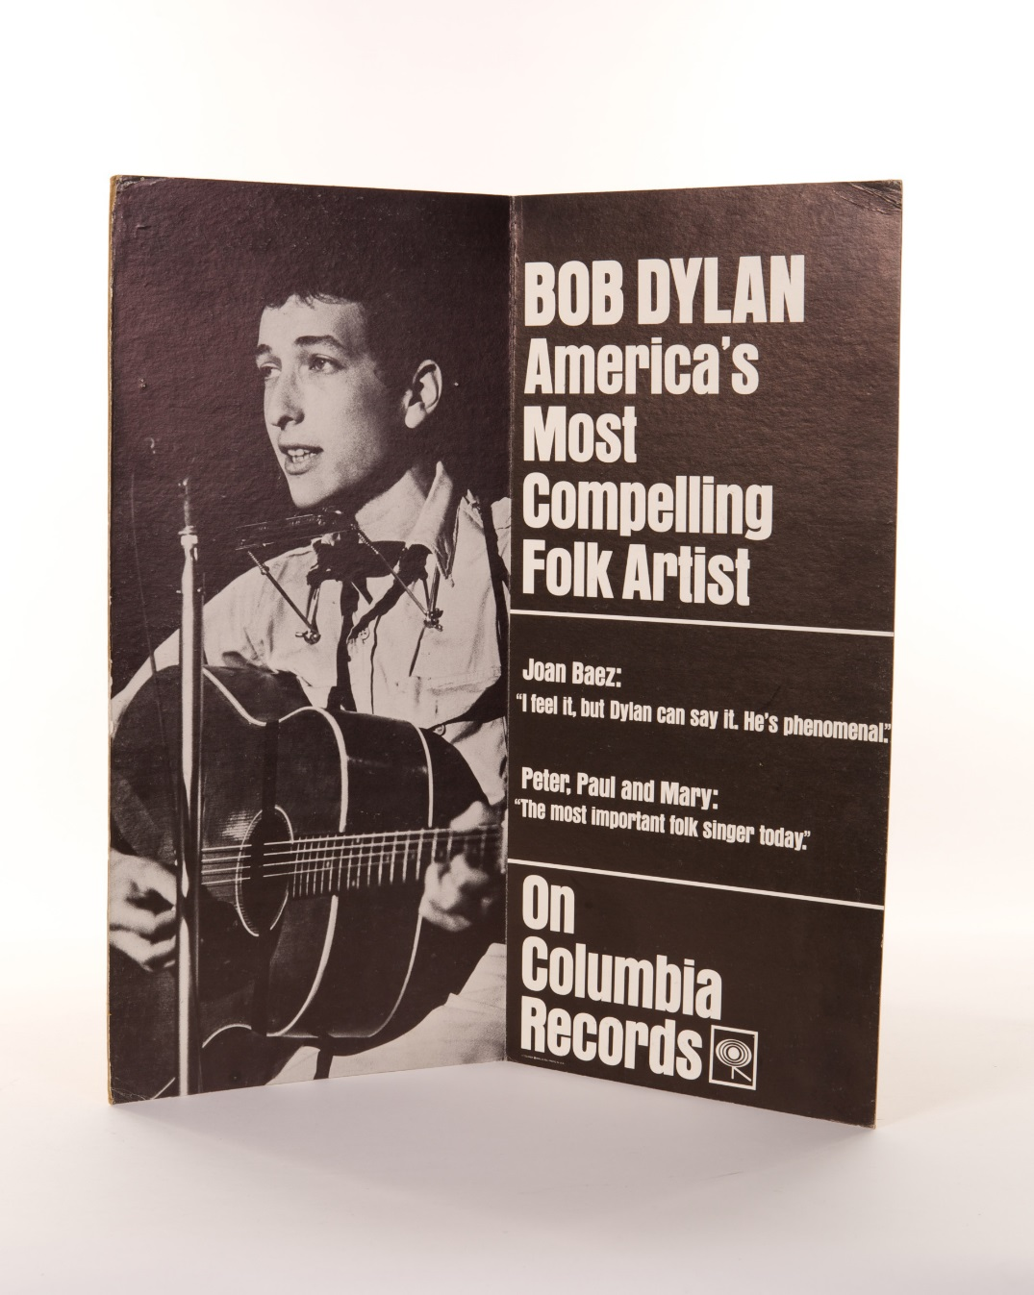
Columbia Records Promotional Display, 1963
Courtesy of Pete Howard/Photo by Bob Delevante

Slide 17
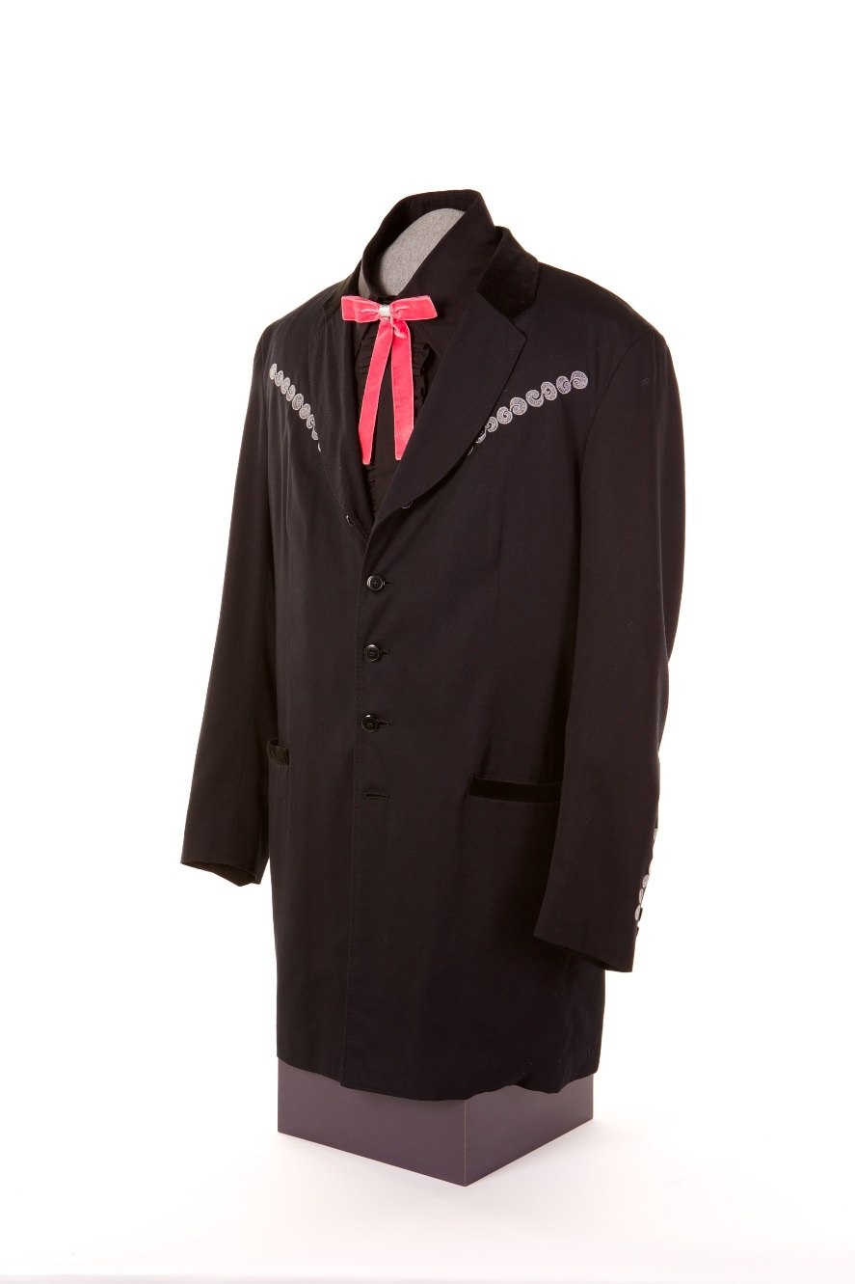
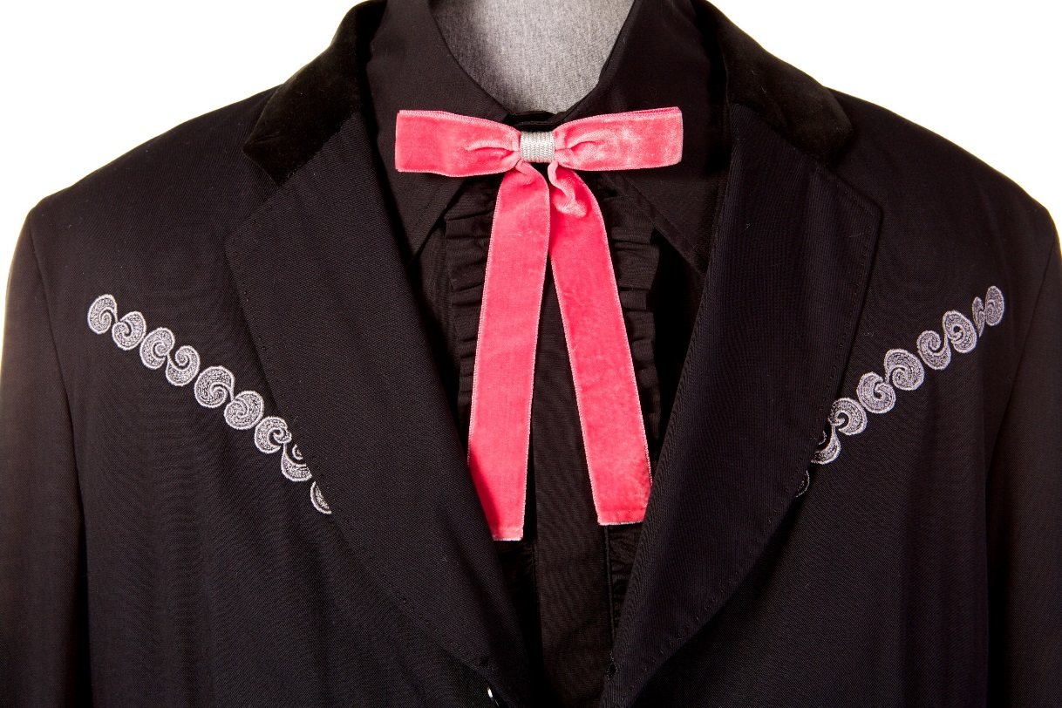
On stage, Dylan frequently wears western-cut clothing such as this jacket made for him by Manuel and this velvet bolo-style tie.
Courtesy of Marty Stuart/Photo by Bob Delevante

Slide 18
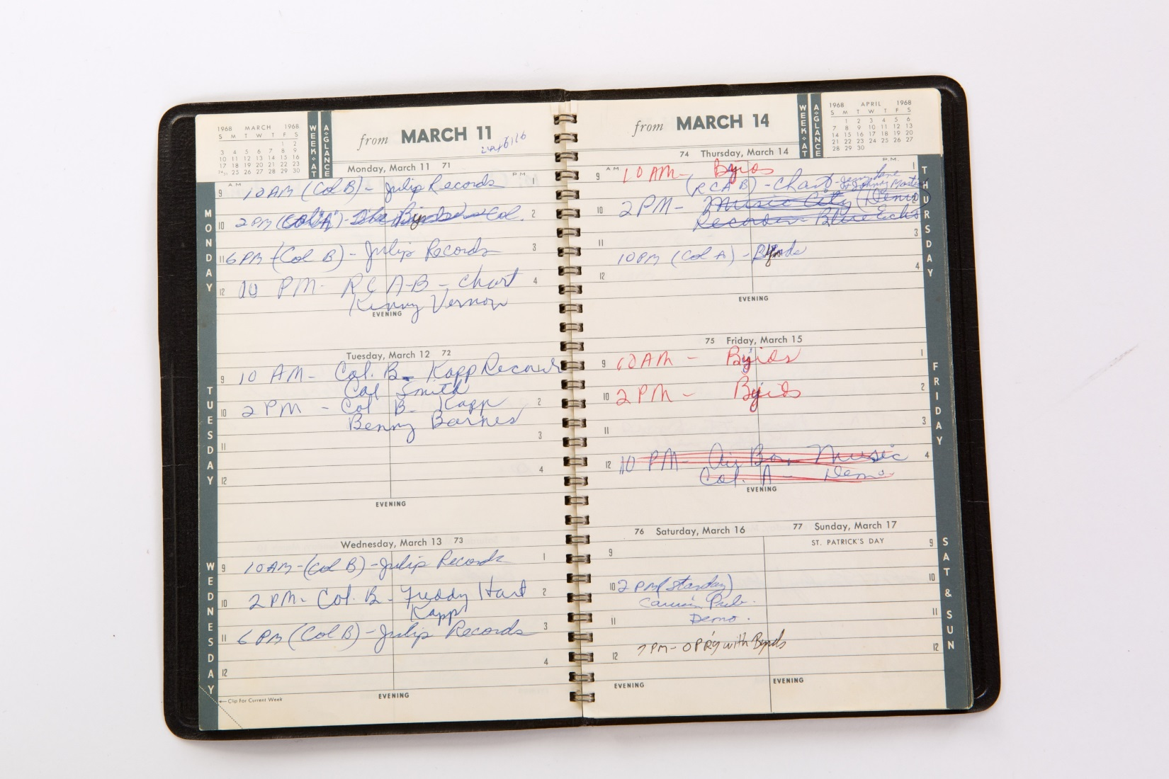
In his 1968, steel guitarist Lloyd Green noted his guest appearance with the Byrds at the Grand Ole Opry on March 16.
Courtesy of Lloyd Green

Slide 19
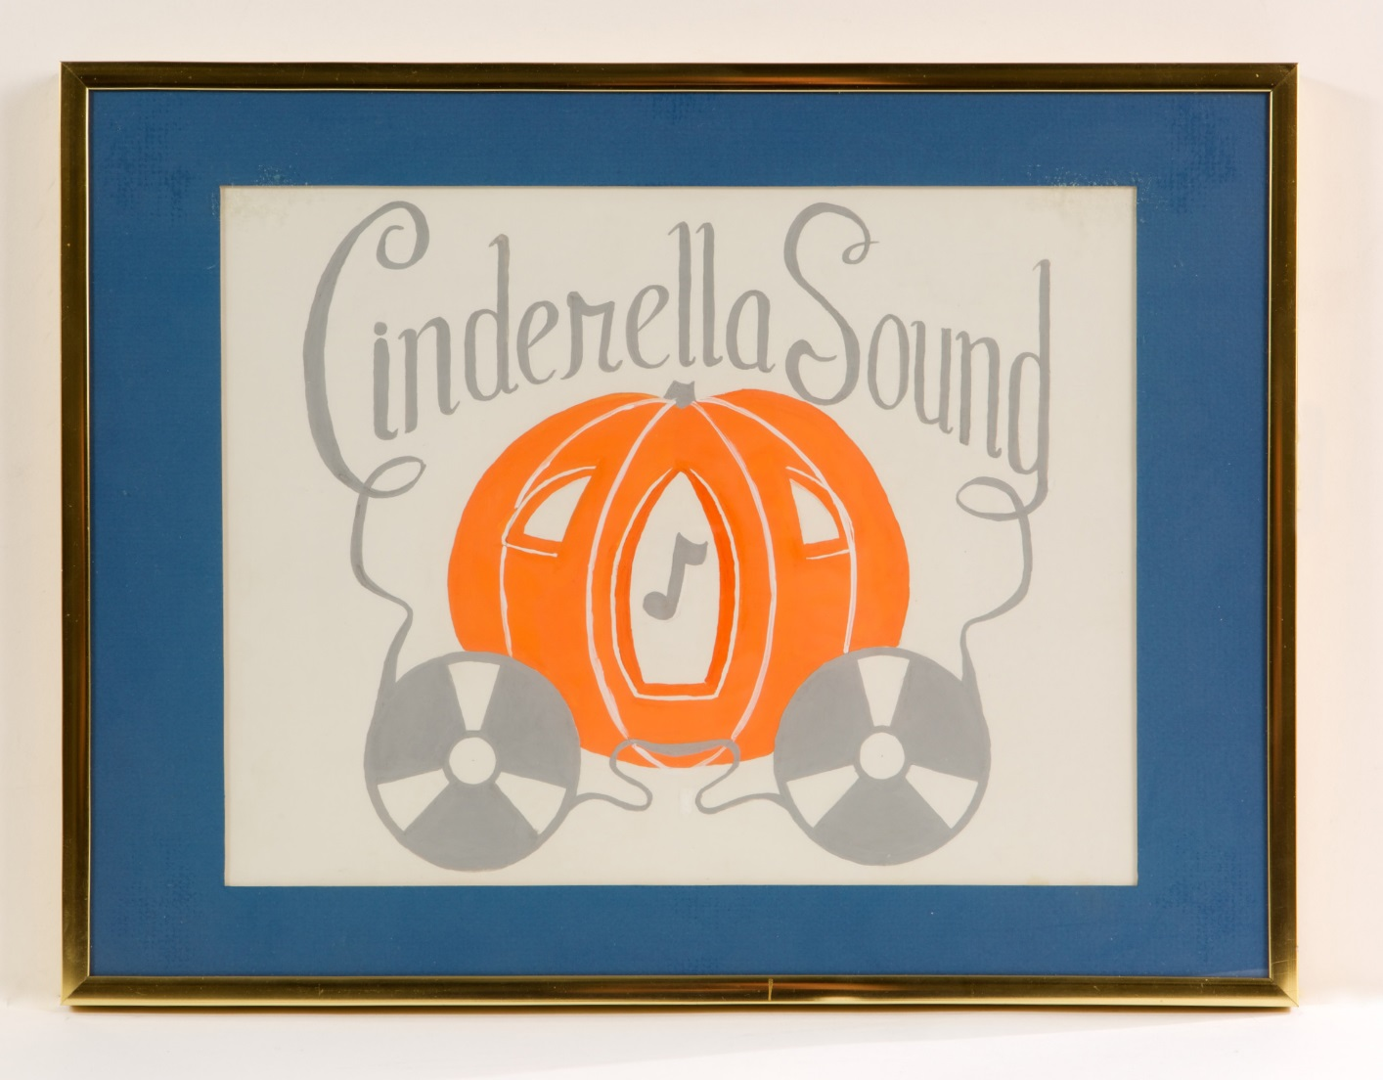
This sign was displayed for decades at Cinderella Sound the Nashville studio owned and operated by guitarist Wayne Moss.
Courtesy of Wayne Moss

