Slide 2
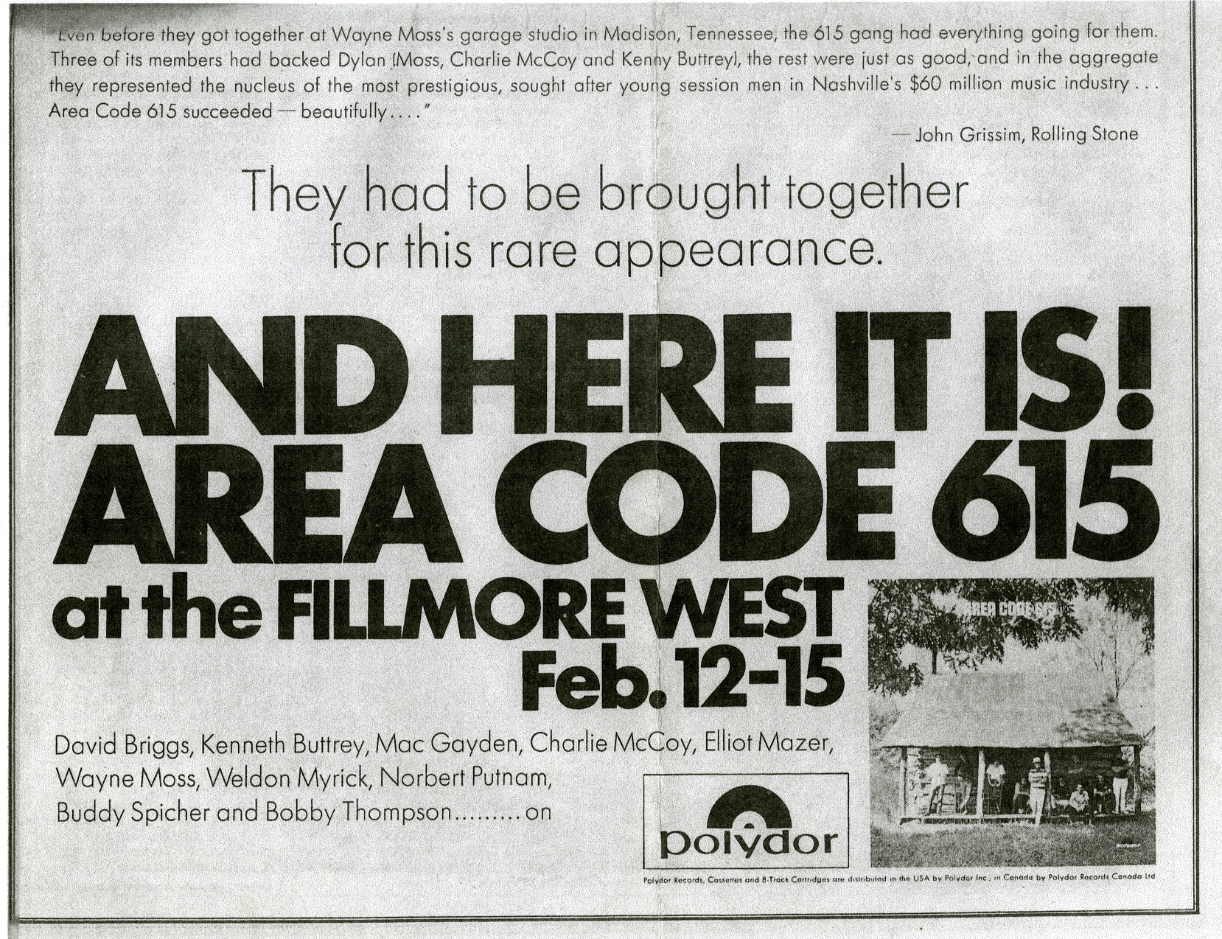
Advertisement from, Rolling Stone magazine, 1971

Slide 3
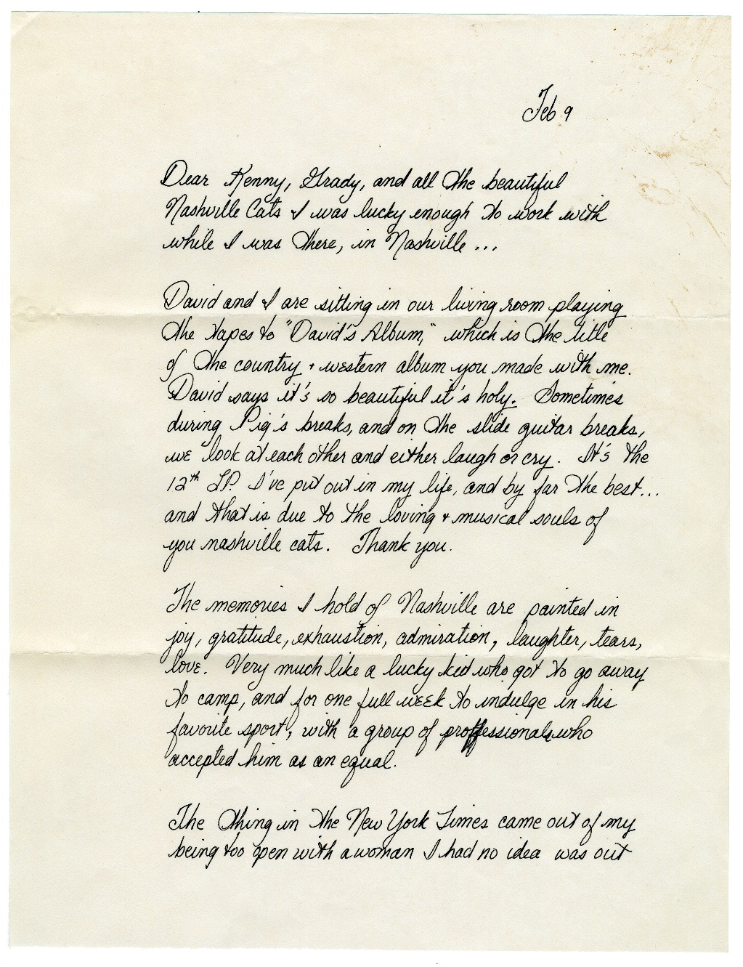
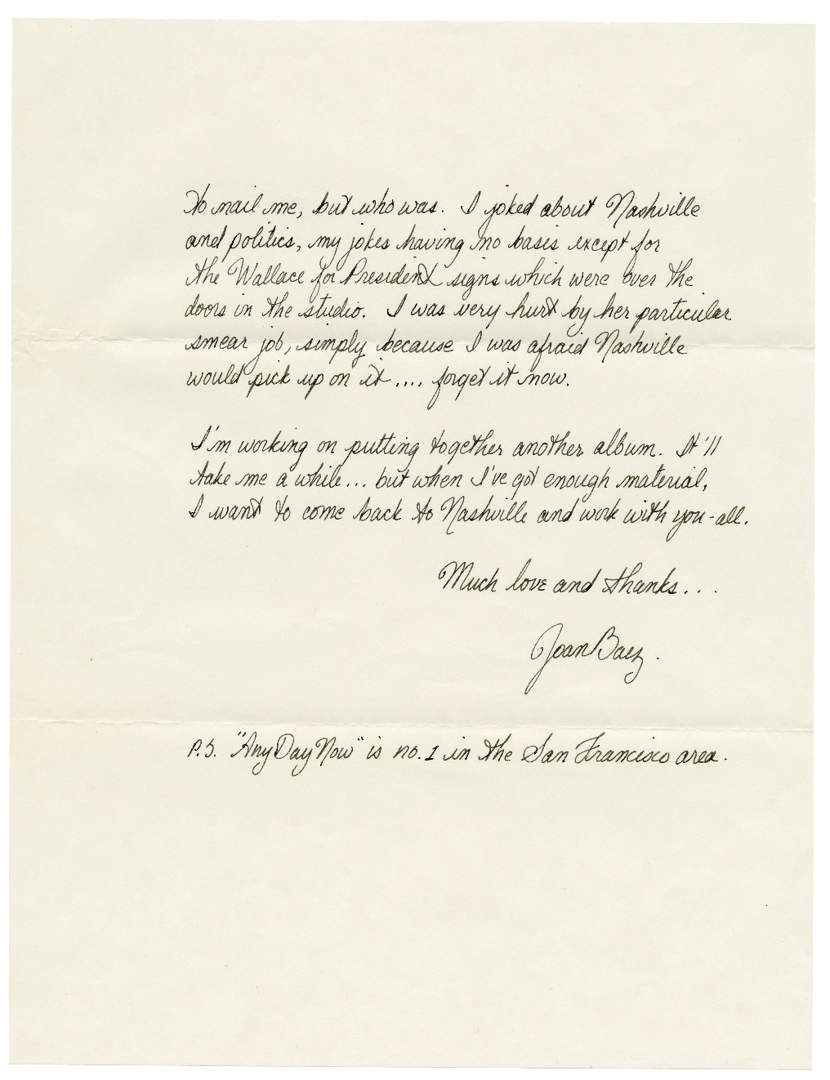
Letter from Joan Baez to the Nashville Cats, February 9, 1969 Courtesy of Todd Buttrey

Slide 4
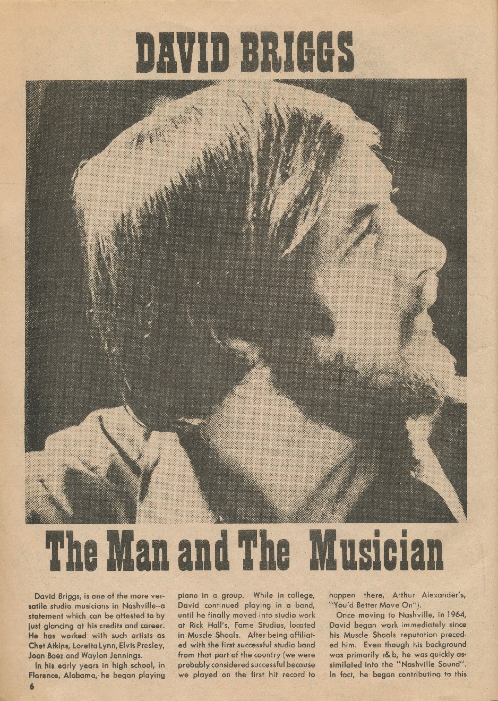
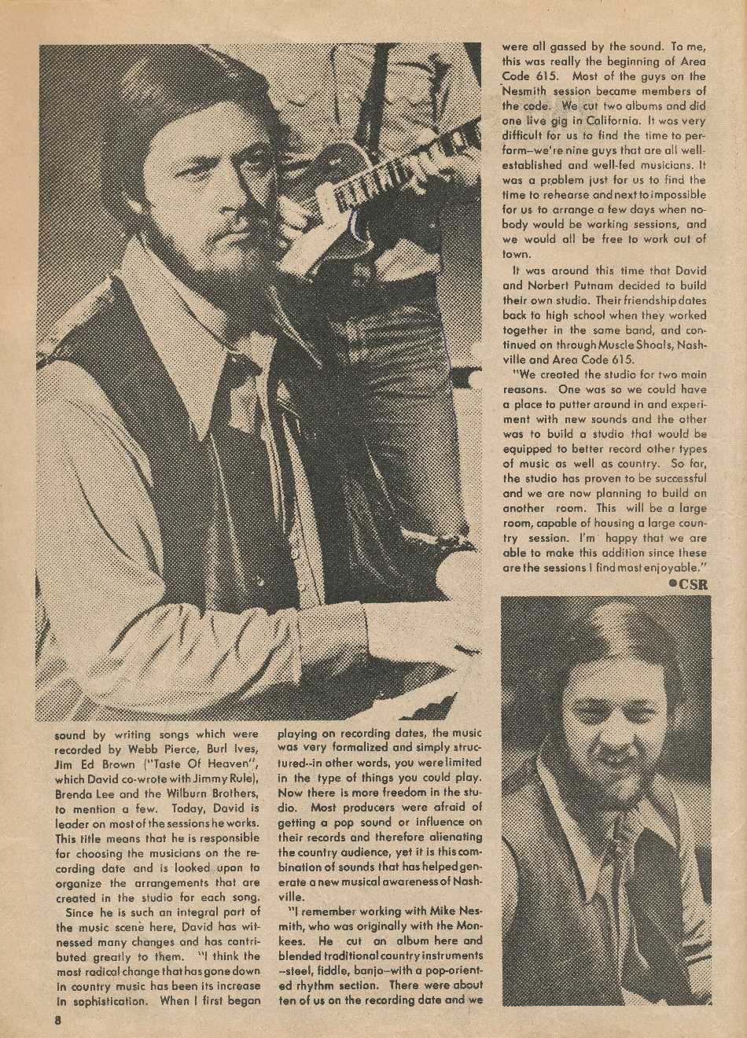
Country Song Roundup, February 1972

Slide 5
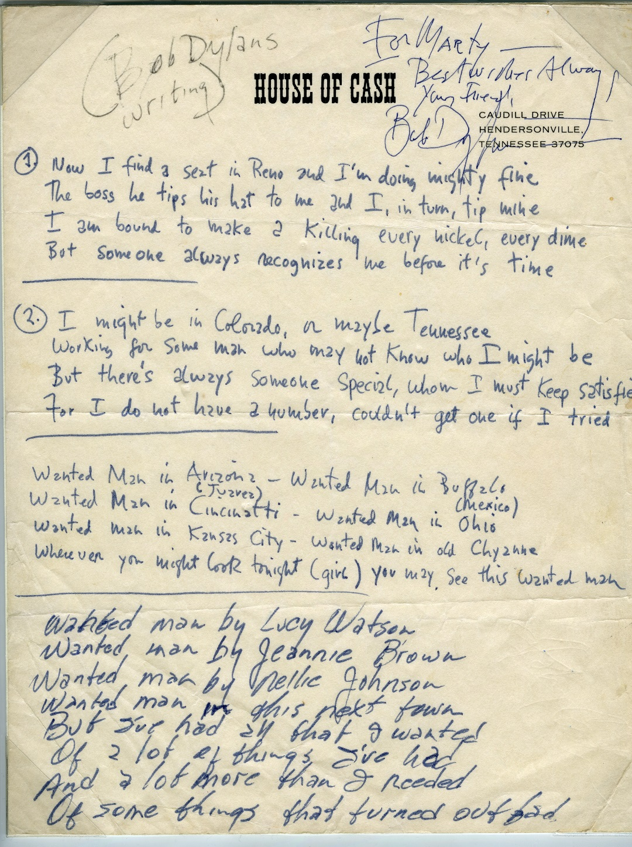
Cash recorded Dylan’s “Wanted Man” for his 1969 chart-topping album Johnny Cash at San Quentin. The first two verses and the chorus are in Dylan’s handwriting on House of Cash stationery. The last verse is in Cash’s hand. Dylan inscribed a message to musician Marty Stuart and signed his name in the top right corner.
Courtesy of Marty Stuart

Slide 6
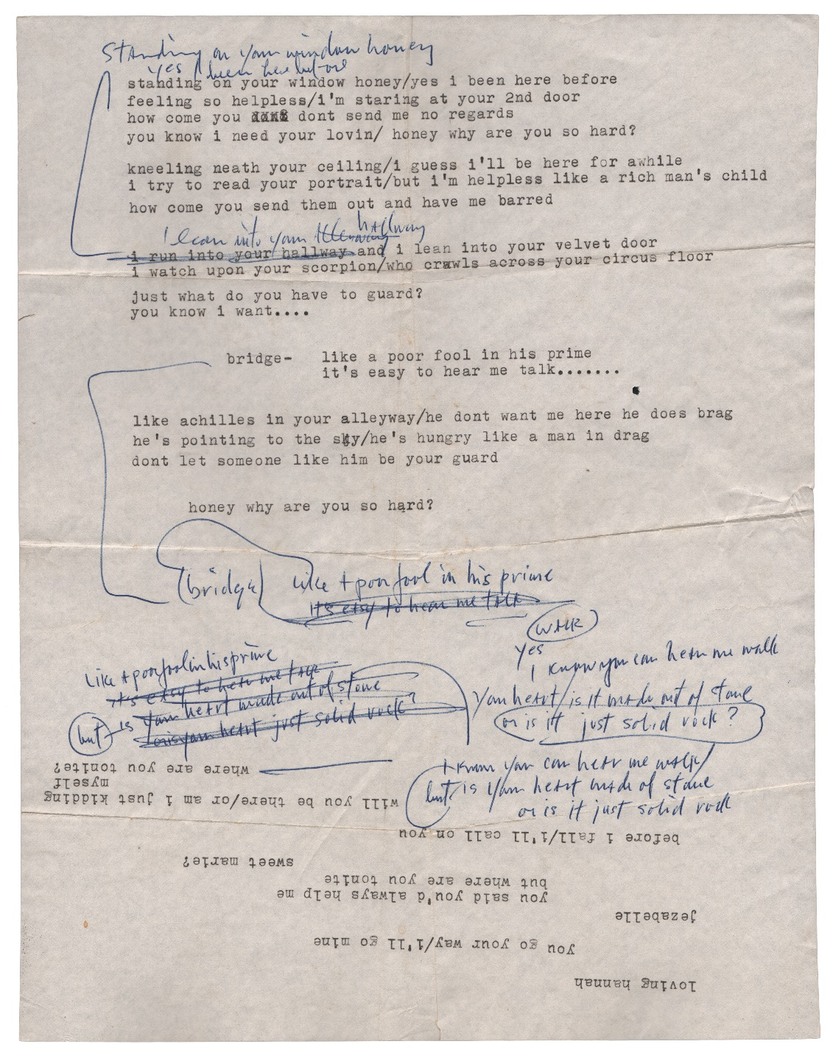
Bob Dylan’s lyrics for “Temporary Like Achilles,” from Blonde on Blonde. Fragments of lyrics from other songs appear at the bottom.
Courtesy of EMP Museum

Slide 7
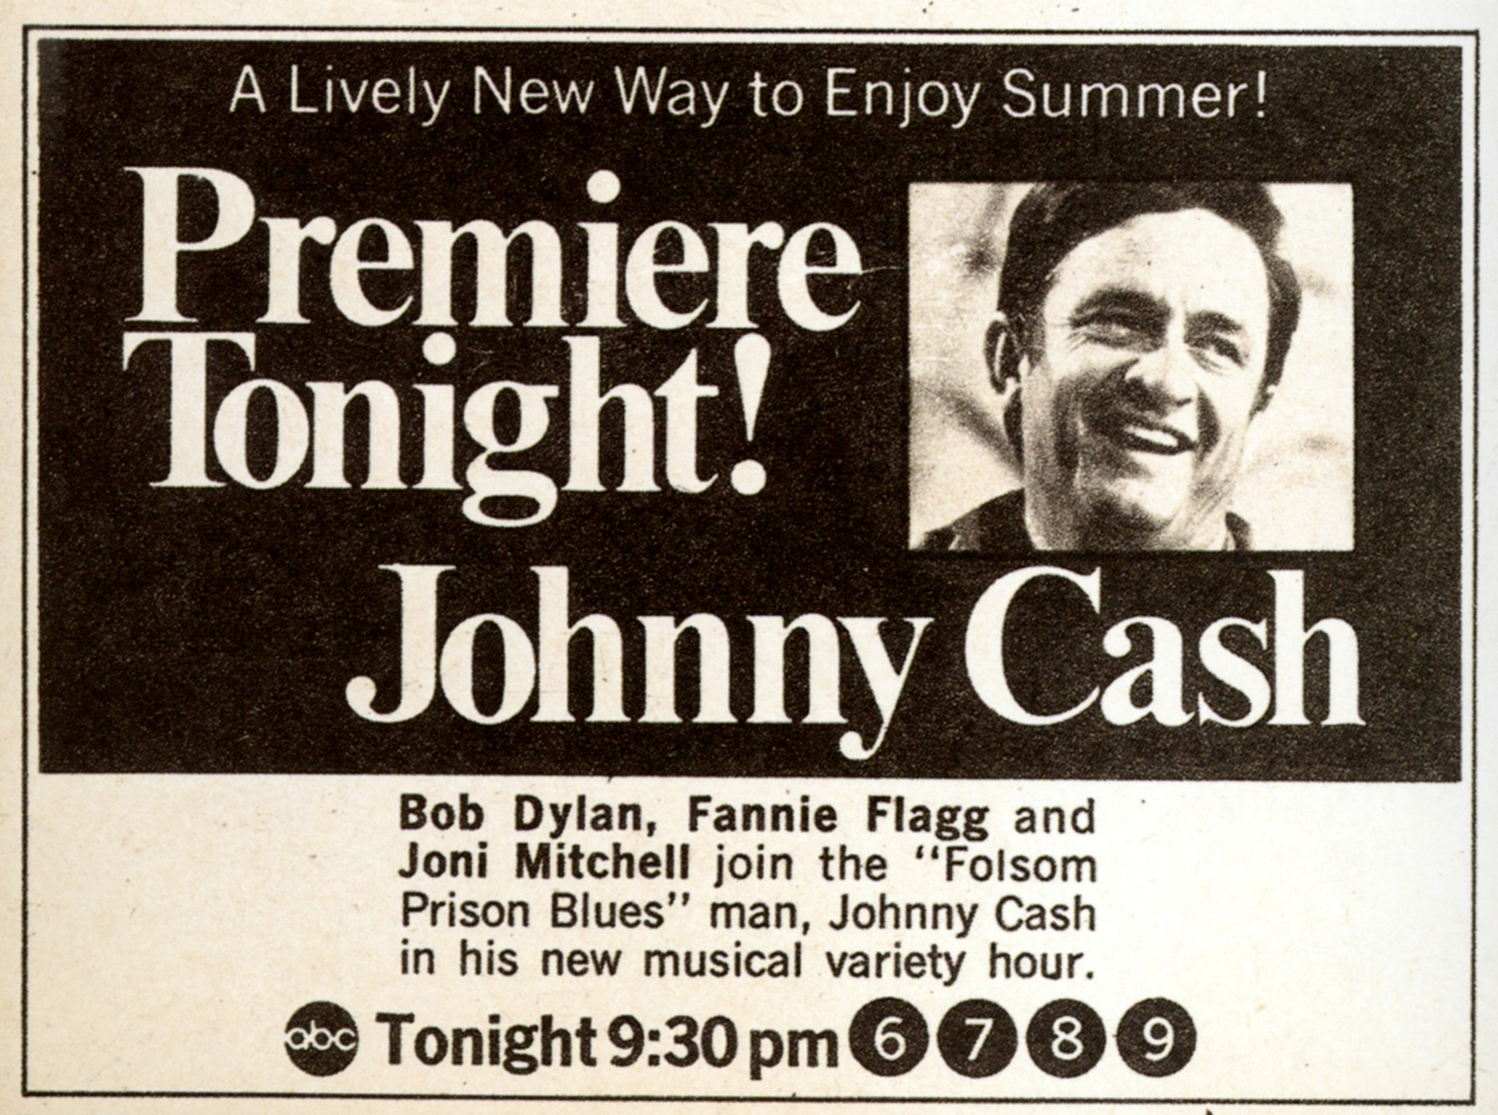
Advertisement for The Johnny Cash Show from TV Guide, 1969

Slide 8
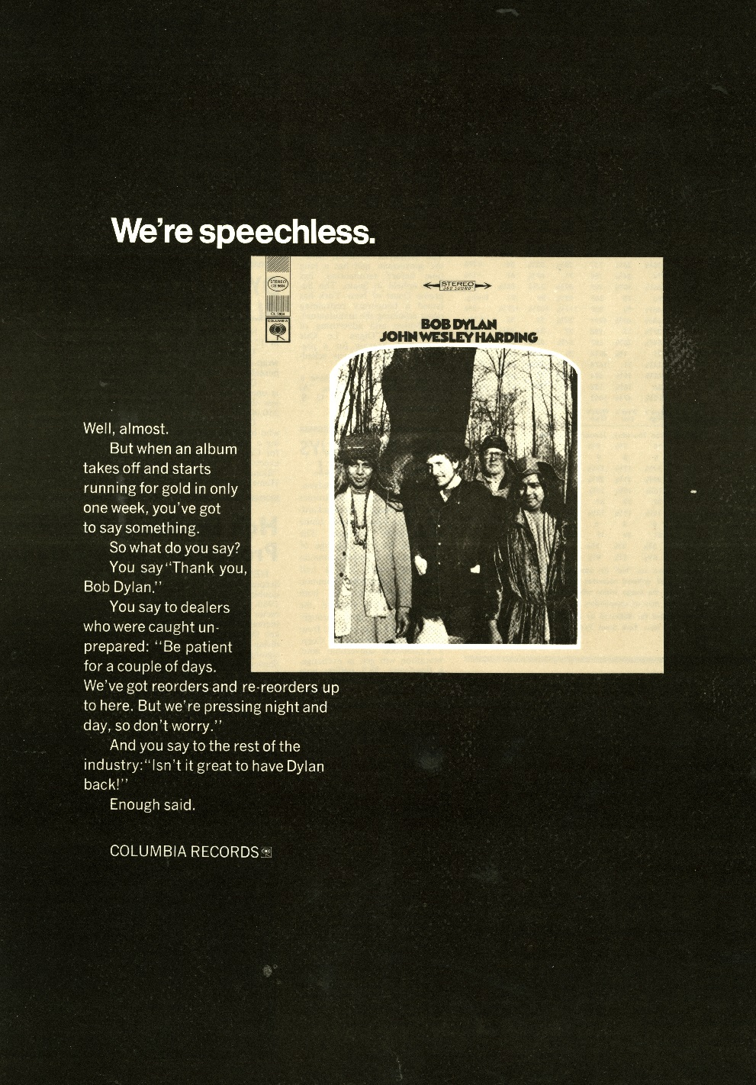
Advertisement for Bob Dylan’s John Wesley Harding, 1967
Courtesy of Paul Wultz

Slide 9
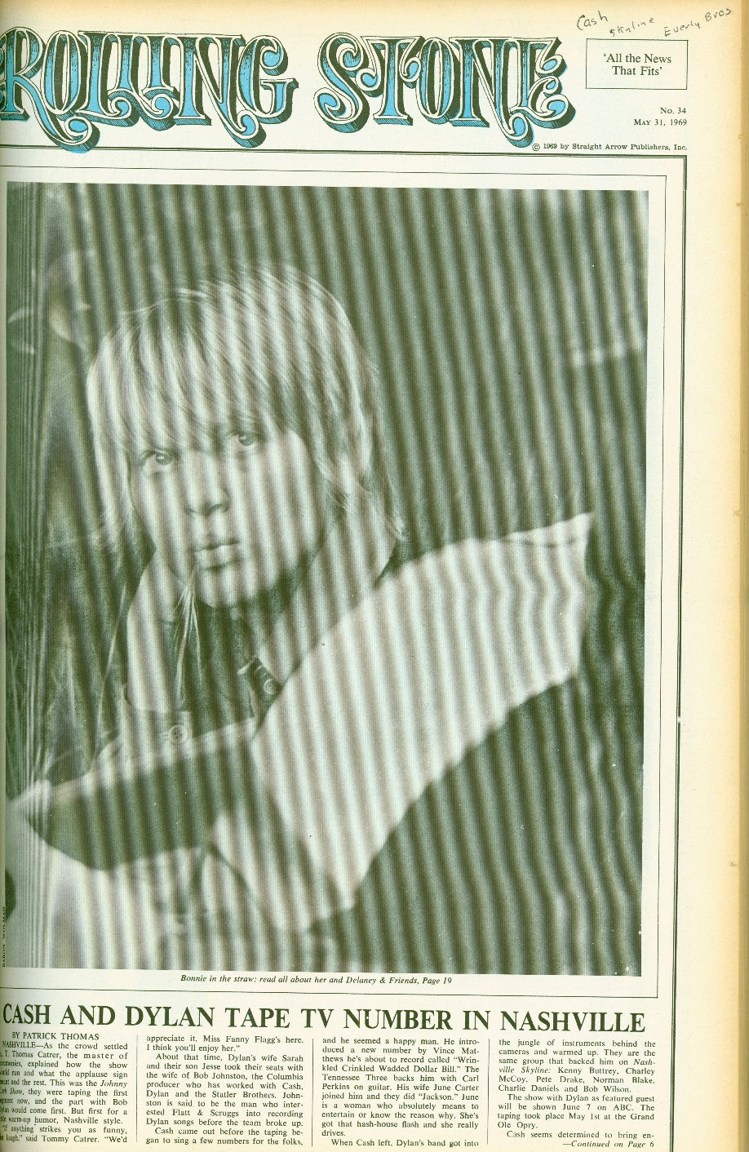
Rolling Stone magazine
May 31, 1969

Slide 10
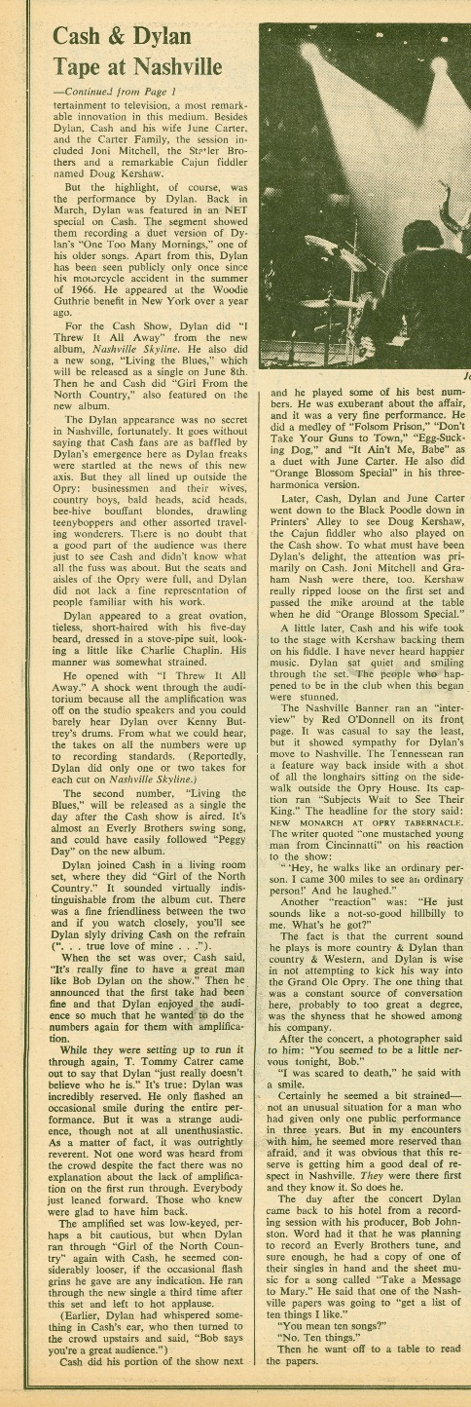
Rolling Stone magazine
May 31, 1969

