Slide 2
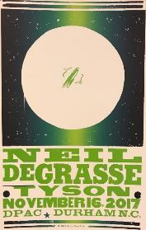
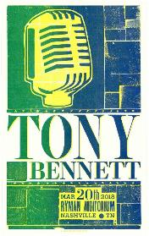
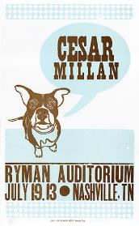
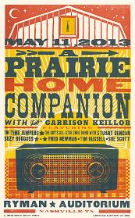
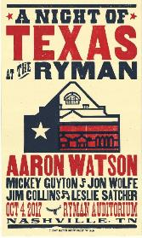
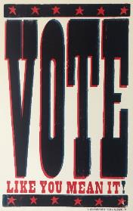
You will be analyzing posters on the following slides. For each poster, answer the following questions:
Was the poster created on a computer or through a letterpress process? How do you know?
What can you infer about the subject or purpose of each poster based on the design?
Notes:
Teacher Note: All of these posters were created by letterpress printing at Hatch Show Print.
Answers about the subject of each print will vary. Additional information for each poster is included in the notes below each slide.

Slide 3
Neil DeGrasse Tyson at Durham Performing Arts Center, November 16, 2017
Notes:
Neil deGrasse Tyson is an astrophysicist, planetary scientist, author, and science communicator.

Slide 4
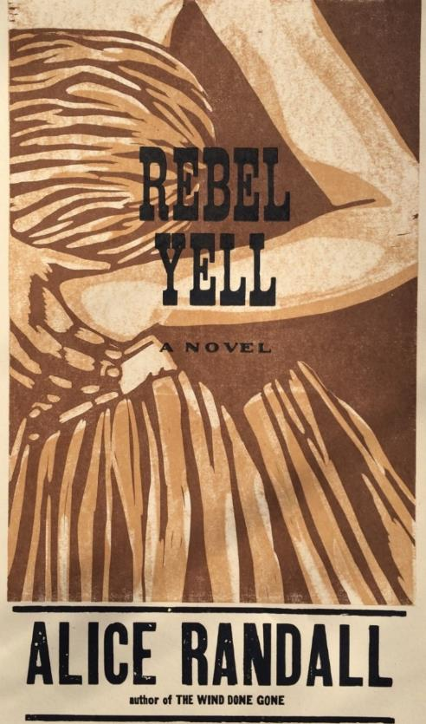
Rebel Yell by Alice Randall
Notes:
Rebel Yell is a novel by New York Times best-selling author and award-winning songwriter Alice Randall. Randall is a professor at Vanderbilt University who teaches courses on soul food, African-American children's literature, African-American film, and creative writing. In her novel The Wind Done Gone, Randall tells an alternative account of the story in Gone with the Wind by Margaret Mitchell.
The rebel yell was a Confederate battle cry during the civil war.

Slide 5
Tony Bennett at Ryman Auditorium, March 20, 2018
Notes:
Tony Bennett is a Grammy-winning singer best known for performing traditional pop and jazz standards. He has been a major recording artist until since the 1950s and continues to record and perform today.

Slide 6
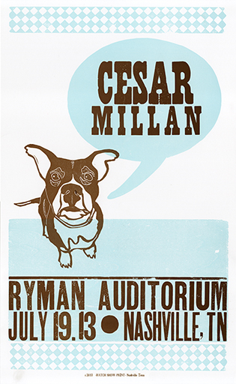
Cesar Millan at Ryman Auditorium, July 19, 2013
Notes:
Cesar Millan is a dog trainer, television personality, and author.

Slide 7
A Prairie Home Companion at Ryman Auditorium, May 11, 2013
Notes:
A Prairie Home Companion was a weekly radio variety program hosted by Garrison Keillor. It aired live from 1974-20016 from the fictional small town of Lake Wobegone, and was known was known for its musical guests, radio drama, and relaxed humor.

Slide 8
A Night of Texas at the Ryman Auditorium, October 4, 2017
Notes:
The building pictured is the Ryman Auditorium. Aaron Watson, Mickey Guyton, Jon Wolfe, Jim Collins, and Leslie Satcher are all songwriters and/or musicians from Texas.

Slide 9
“Vote Like You Mean It” is sold in the Hatch Show Print retail store.
Notes:
No representative or political party is affiliated with this print.

