Slide 1
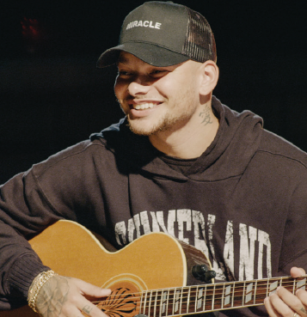
INTRODUCTION to SONGWRITING
Lesson 1 | Grades 7-12

Slide 2
Discussion
Name some of your favorite songs.
What do you like about those songs?

Slide 3
Discussion
List as many parts of a song as you can.
Can you define each part?

Slide 4
Let’s explore the different parts of a song!
The title is the name of the song.
The subject is the topic of the song.
The theme is the message of the song.

Slide 5
The hook is the part of the song that catches, or “hooks,” a listener’s attention and makes the song easy to remember.
The title and hook are often the same, and the hook is usually repeated throughout the song.

Slide 6
The verse communicates the details of the song, such as, who, what, when, where, why, and how. Songs usually have multiple verses.
The chorus is the part that is repeated throughout the song. It is usually simpler than the verses, and it often contains the hook.

Slide 7
The bridge introduces a twist or new idea on the subject. It usually occurs toward the song’s end, and it has a different melody from the verses and chorus.
Note that not all songs have a bridge.

Slide 8
LISTEN
Read the song lyrics, and then follow along as a recording of the song is played.
Circle the chorus and underline the hook and title.

Slide 9
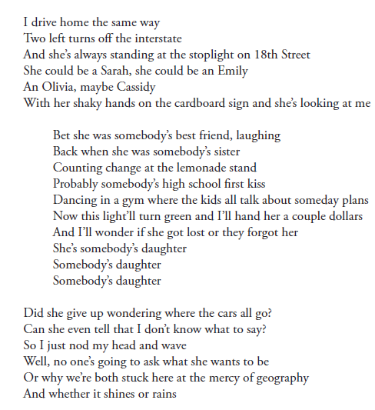
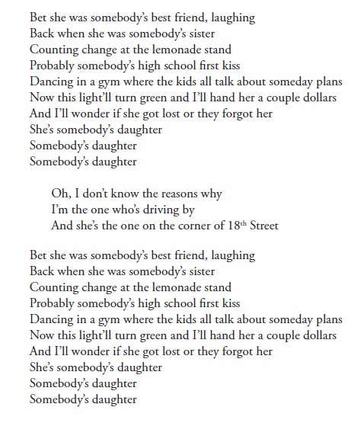
Click here for the song.

Slide 10
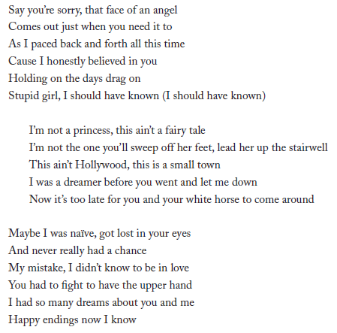
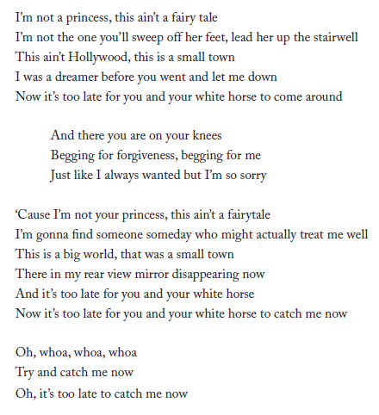
Click here for the song.

Slide 11
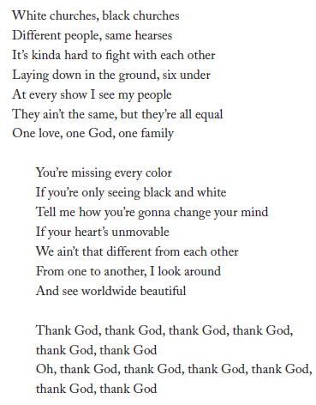
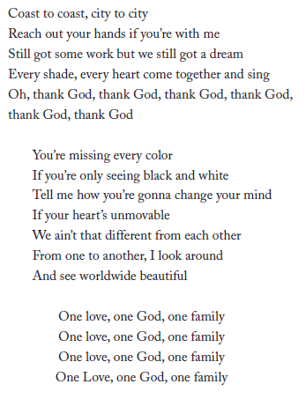
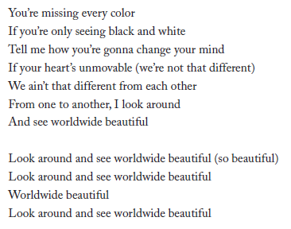
Click here for the song.

Slide 12
Listen
Identify the song’s rhyme scheme (e.g., ABAB, AABB, etc.)
Note: the chorus, verses, and bridge may have different rhyme schemes.

Slide 13
Discussion
The subject is what the song is about.
The theme is the message of the song.
What is the subject and theme of the song?

Slide 14
Discussion
Common human experiences are actions, thoughts, or feelings others can relate to.
Brainstorm a few examples of common human experiences as a class.

Slide 15
Homework
Brainstorm your own list of common human experiences and potential song topics:
List three common human experiences you might share as a class.
List three things that you think about a lot.
Write down the first funny memory that comes to your mind.
Write down the first two happy memories that come to your mind.
Write down the first two sad memories that come to your mind.

Slide 16
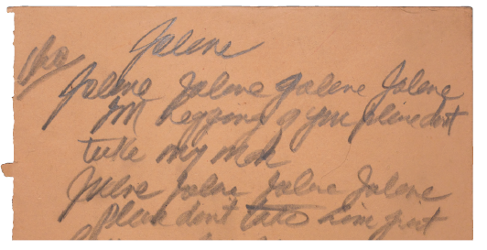
Song topic and Outline
Lesson 2 | Grades 7-12

Slide 17
Let’s review!
Parts of a song
A song must have a title, verses, a chorus and a hook.
Some songs have a bridge.

Slide 18
Let’s review!
Title and hook
In most songs, the title appears at least once in the chorus.
The title is often the hook, the catchy phrase that makes the song easy to remember.

Slide 19
Let’s review!
Subject and Theme
The subject is the song’s topic.
The theme is the message.

Slide 20
Let’s review!
Common Human Experiences
Share your list of common human experiences with the class.

Slide 21
Discussion
Pick a song subject.
Brainstorm a theme, or message, you want to communicate about the subject.
Brainstorm more descriptive words, activities, feelings, or ideas related to the subject and theme.

Slide 22
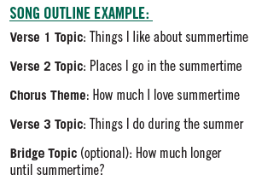
Make a song outline
An outline is a rough sketch of what the lyrics will communicate.
It’s a useful way to help writers organize their thoughts.
Using the main idea and details you came up with, make an outline of your song together as a class.

Slide 23
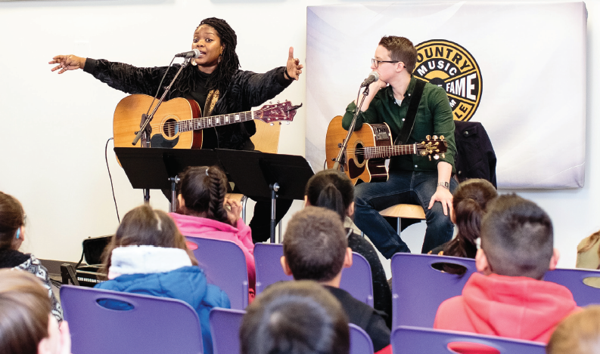
Songwriter session
A songwriter will collaborate with the class on the content of the song, the style of music, and other aspects of songwriting.
Prepare questions to ask the songwriter at the end of the program!

