Slide 1
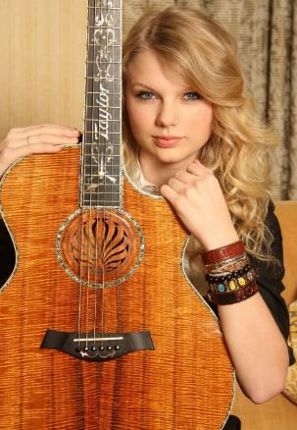
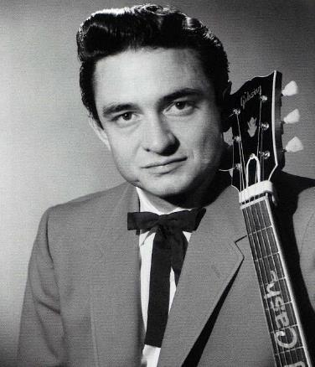
WHAT IS SONGWRITING?
Lesson 1 | Grades 7-12

Slide 2
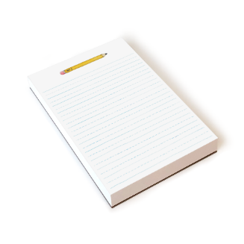
Songwriting
pre-assessment
Try writing a song using the Try a Song Handout!
Don’t worry about whether you do it right or wrong.
There are no wrong answers.
This should be your own song, not a song you know or have heard before.

Slide 3
BRAINSTORM
In your journal, list as many of your favorite songs as you can in two minutes.
Ready… set…GO!

Slide 4
GROUP DISCUSSION
Who writes songs?
Why do people write songs?
Why do people like songs?
What skills are needed to write a good song?
What makes a song good?
Are you familiar with any songwriters?
Have you ever tried to write a song?
What makes songs the same or different as poems?

Slide 5
ACTIVITY
Select two or three favorite songs from the list in your journal.
Use the Internet to complete the following steps for each song:
Find the name of the songwriter. If there is more than one, list all of them.
Find the name of the performer.
Find two other songs written by the songwriter. If there are multiple writers, choose just one of them.
Write down the song title and performer for each new song you find.

Slide 6
Activity
As a class, discuss what you found in your research.
What new things did you learn about your songwriters?
Did any of the research surprise you?
Was your song performed by a songwriter?
People often co-write songs, which means that two or more people work together to write a song. Was your song co-written?

Slide 7
REFLECTION
Answer the following questions in your journal.
What makes you EXCITED about writing a song?
What makes you NERVOUS about writing a song?

Slide 8
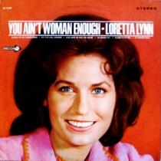
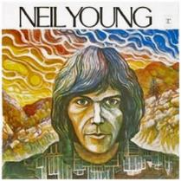
HOMEWORK
Songwriter Quotes Worksheet
Read the quotes from professional songwriters.
In your journal, write one to two sentences about what each quote teaches you about songwriting.
If you connect with a quote on a personal level, write a sentence to explain why.

