Slide 2
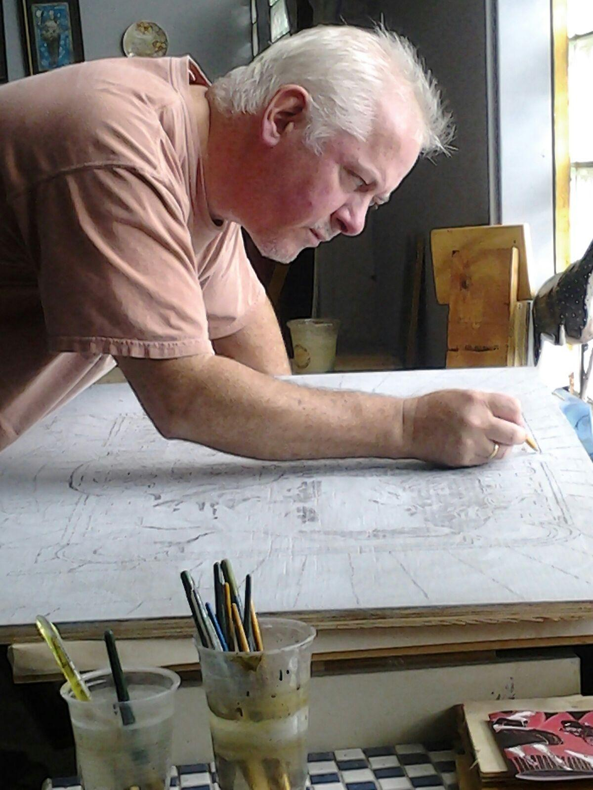
Jon Langford
Born in Newport, Wales
Studied Fine Art at Leeds University
Founding member of punk band, the Mekons
Known for portraits of country and rock icons
CMHOF commissioned him to create main exhibit image
Jon Langford at work in his Chicago studio

Slide 3
Jon Langford

Slide 4
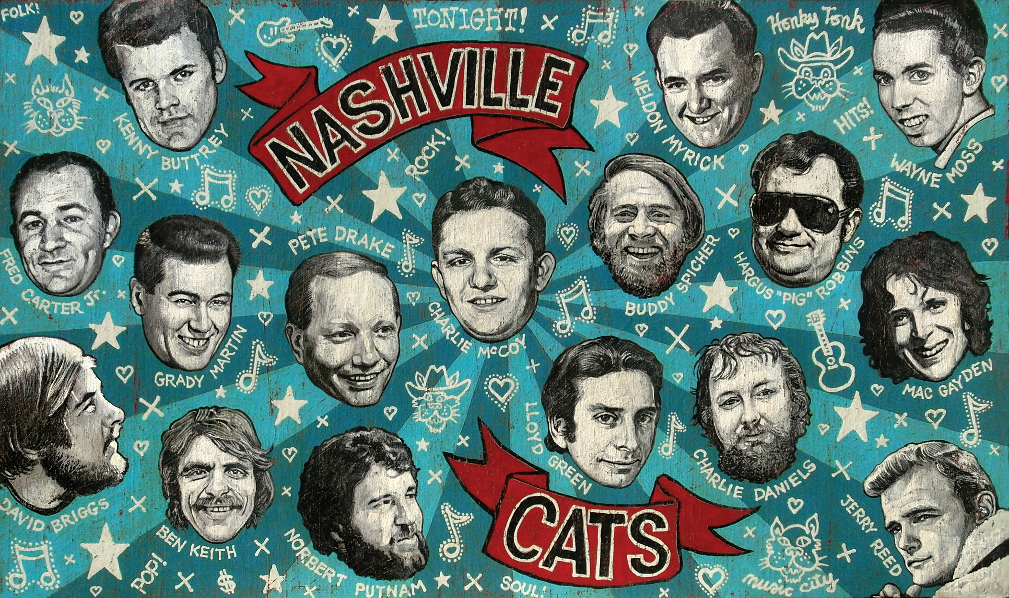
Jon Langford

Slide 5
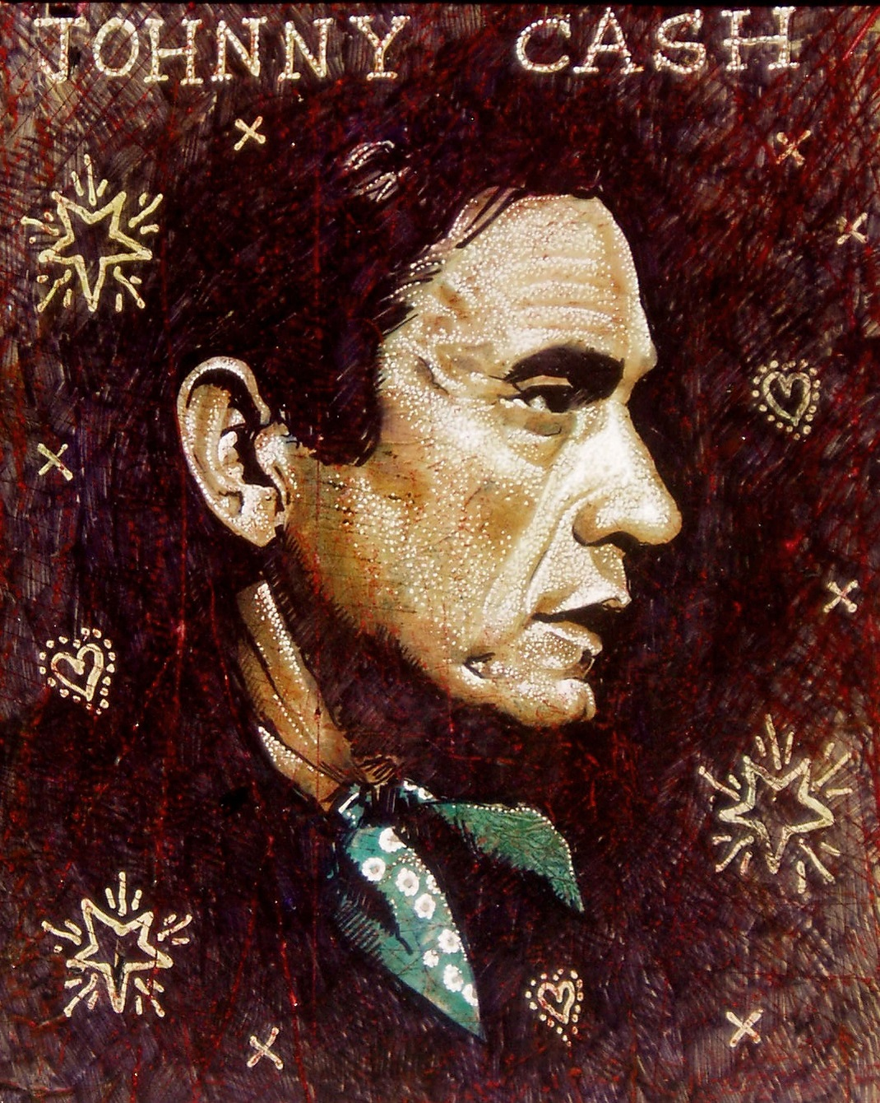
Jon Langford

Slide 6
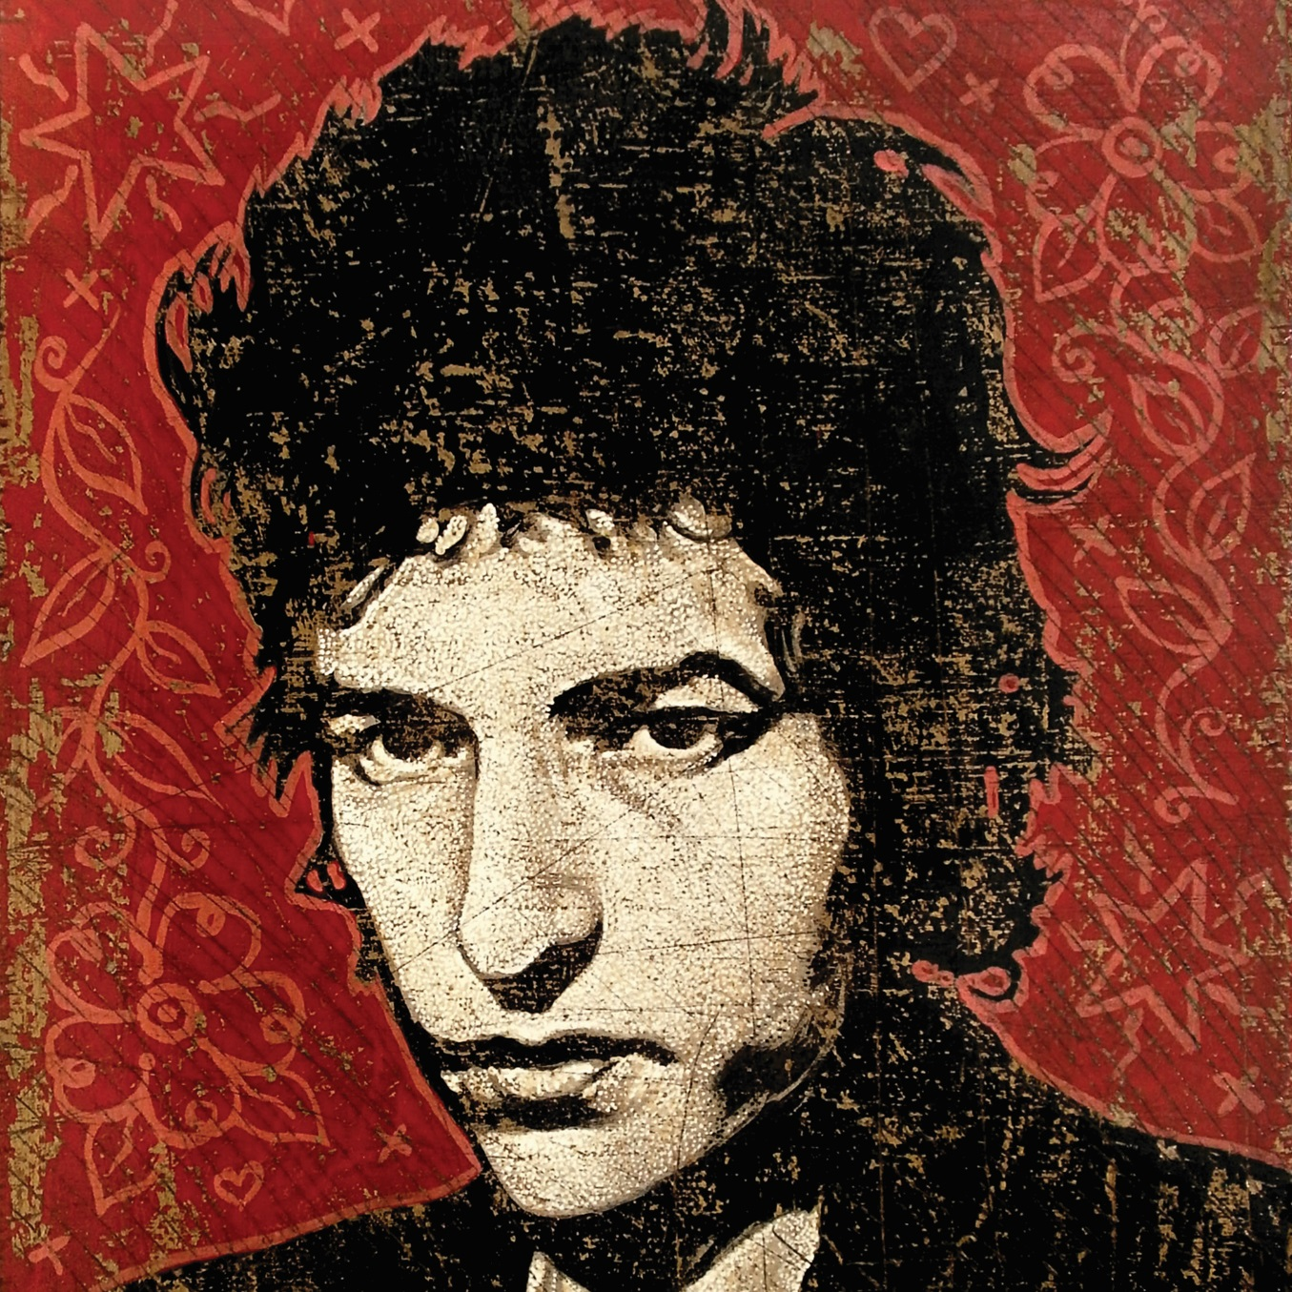
Jon Langford

Slide 7
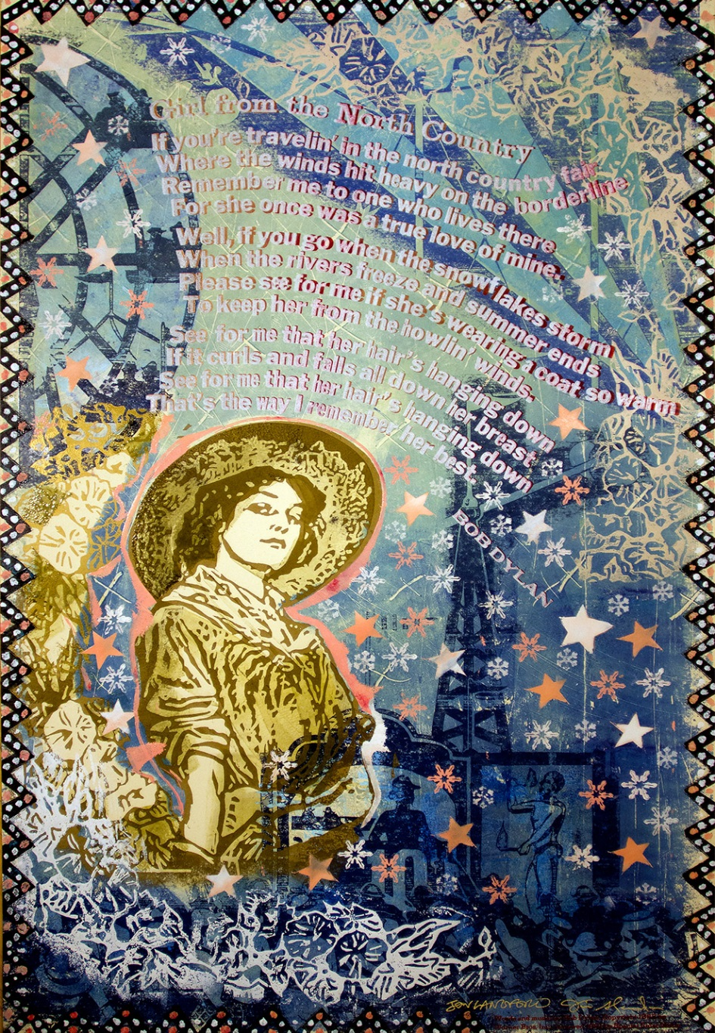
Girl from the North Country
In Collaboration: Jon Langford and Jim Sherraden

