Slide 1
SUBJECT AND TITLE
Lesson 3 | Grades 3-6

Slide 2
FREE WRITE
Do: Write about anything on your mind.
Do: Focus on writing for the entire five minutes.
Do: Keep your pen or pencil moving for the whole five minutes.
Don’t: Worry about conventions like spelling or punctuation.

Slide 3
BRAINSTORM
Human experiences are actions, thoughts, or feelings that many people can relate to.
In your journal, write down as many common human experiences as you can in one minute.
Ready… set…. GO!

Slide 4
Compare your lists with your group.
Circle anything on your list that you have in common with another group member’s list.
Discussion

Slide 5
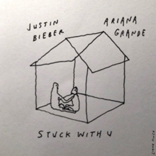
ACTIVITY
A song title often comes from things heard in daily life. This can be a cool phrase, a line in a movie or TV show, or something repeated all the time.
Sometimes titles tell us what the song is about.
(“Stuck With U,“ performed by Ariana Grande and Justin Bieber)
Other titles may not tell us everything about the subject.
(“Cardigan,” performed by Taylor Swift)
Can you think of more examples like these?

Slide 6
“Country Girl”
What do you think the song will be about?
Do you think the songwriters made up the title?
Or do you think they heard the phrase somewhere else in their daily lives?

Slide 7
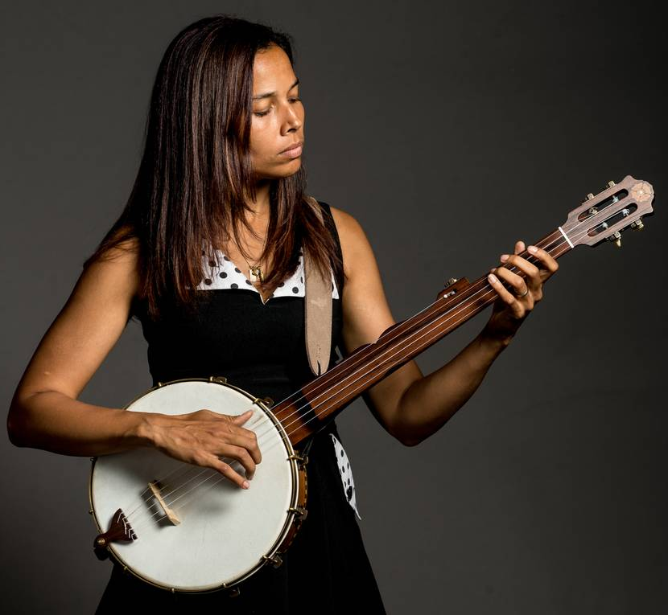
LISTEN
“Country Girl”
Written by Rhiannon Giddens, Lalenja Harrington, and Adam Matta
As you listen, think about:
How is the title used in the song?
What makes the title catchy?
What is the relationship between the title, hook, and chorus?
Click here for the song.

Slide 8
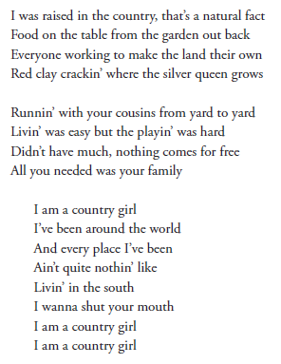
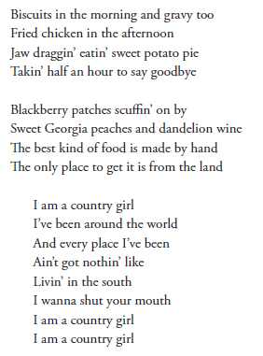
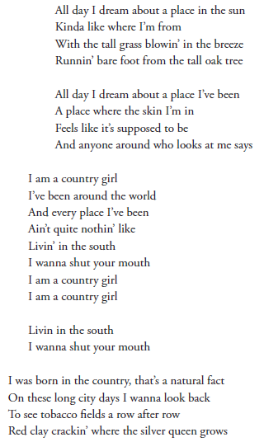

Slide 9
REFLECTION
List the following items in your journal:
Three things that you think about a lot.
Three objects or ideas that are important to you.
The first two happy memories that come to your mind.
The first two sad memories that come to your mind.
The first funny memory that comes to your mind.

Slide 10
Using the Writing Titles and Hooks Worksheet ...
Look over the list you just created.
Pick one or two subjects to practice writing song titles and themes.
Create three possible song titles (which can also serve as hooks) for each subject.

Slide 11
HOMEWORK
Journal Entry
Titles can come from anywhere! For the rest of the school day and tonight when you go home, use your journal to record anything catchy you hear.
Write down as many titles as you can.
You will share your favorite titles with the class tomorrow.

