Slide 1
THEME AND MESSAGE
Lesson 4 | Grades 3-6

Slide 2
FREE WRITE
Do: Write about anything on your mind.
Do: Focus on writing for the entire five minutes.
Do: Keep your pen or pencil moving for the whole five minutes.
Don’t: Worry about conventions like spelling or punctuation.

Slide 3
BRAINSTORM
A popular song is one that has been heard by millions of people on the radio, Internet or television.
In your journal, write down the titles of as many popular songs as you can think of in one minute.
Ready… set… GO!

Slide 4
ACTIVITY
Let’s look at a popular song:
What is the theme of this song?
Is that theme reflected in the title? How?
Is the title ever sung in the song?
In what part of the song does that happen?

Slide 5
LISTEN
“On the Road Again”
Written and performed by Willie Nelson
Discuss:
What is the subject and what is the theme?
What evidence from the song supports your position?
Click here for the song.

Slide 6
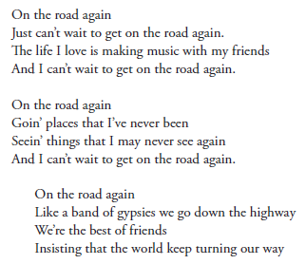
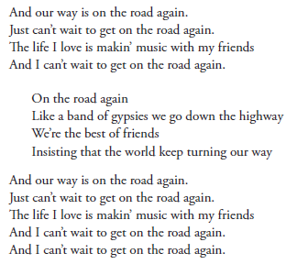

Slide 7
Discuss
What is the subject of this song?
What evidence from the song supports your position?
The theme is the message of the song. What is the theme?
What evidence from the song supports your position?
What do the lyrics imply about how Willie Nelson feels when he is not on the road?
What evidence from the song makes you think so?

Slide 8
LISTEN
“Forever and Ever, Amen”
Written by Paul Overstreet and Don Schlitz
Performed by Randy Travis
Discuss:
What is the subject and what is the theme?
What evidence from the song supports your position?
Click here for the song.

Slide 9
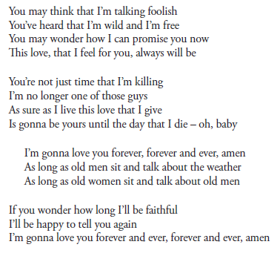
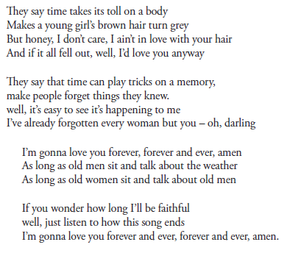

Slide 10
LISTEN
“Love Hurts”
Written by Boudleaux Bryant
Performed by Emmylou Harris and Rodney Crowell
Discuss:
What is the subject and what is the theme?
What evidence from the song supports your position?
Click here for the song.

Slide 11
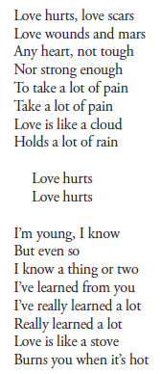
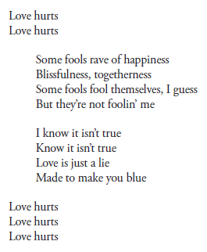

Slide 12
Activity
Answer the following questions on the Subject and Theme Worksheet:
What is the subject of “Forever and Ever, Amen”?
What is the theme of “Forever and Ever, Amen”? What is your evidence?
What is the subject of “Love Hurts”?
What is the theme of “Love Hurts”? What is your evidence?

Slide 13
HOMEWORK
Journal Entry
Look over your previous writing and find a theme to write more about in your journal.
Your writing can take the form of an essay, a story, a poem, a thoughtfully drawn comic strip, or lyrics.
Remember to include a title that reflects the subject of whatever you write.

