Slide 1
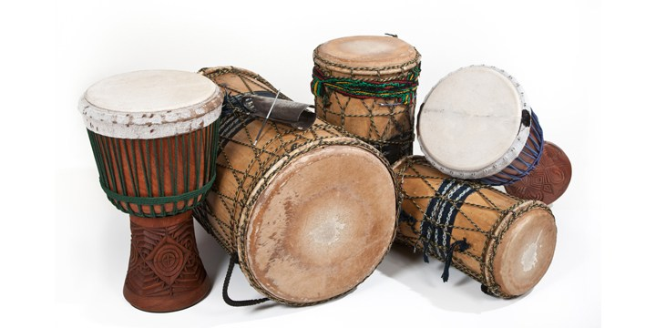
RHYTHM AND SYLLABLES
Lesson 5 | Grades 3-6

Slide 2
FREE WRITE
Do: Write about anything on your mind.
Do: Focus on writing for the entire five minutes.
Do: Keep your pen or pencil moving for the whole five minutes.
Don’t: Worry about conventions like spelling or punctuation.

Slide 3
BRAINSTORM
In your journal, spend one minute defining rhythm and naming places where you hear rhythm.
Ready… set… GO!

Slide 4
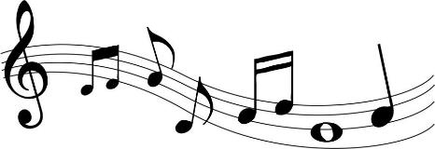
ACTIVITY
Words + Music = a Song!
For lyrics to fit well with music, songwriters
need to learn about rhythm and syllables.
Rhythm is a pattern of sounds and silences.
Syllables are the parts that a word is naturally divided
into when it is pronounced.

Slide 5
Compare the lyrics below.
Does something sound wrong?
"The Star-Spangled Banner"
And the rocket’s red glare
The bombs bursting in air
Gave proof through the night
That our flag was still there
And the rocket’s red glare
The bombs exploding all over the place
Gave proof through the night
That our flag was still there
VS.

Slide 6
Compare the lyrics below.
Does something sound wrong?
“We Will Rock You”
We will, we will rock you
We will, we will rock you
VS.
We will, we will rock you
We will, we will beat you really bad

Slide 7
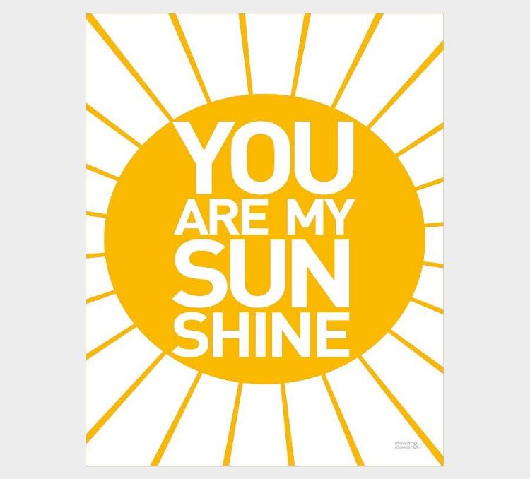
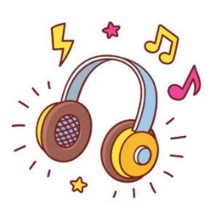
Listen
Listen to a recording of “You Are My Sunshine.”
Using the Rhythm and Syllables Worksheet, count the number of syllables in each line.
Write down the number of syllables in each blank on the worksheet.
Add a few words to one line of each verse. How does this affect the line’s fit with the others?
Click here for the song
(performed by
Jimmie Davis)
Click here for the song
(performed by Ray Charles)

Slide 8
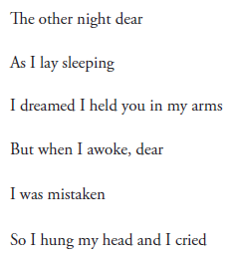
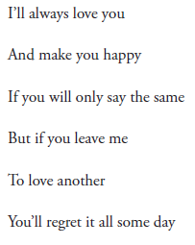

Slide 9
DISCUSSION
What happened when you added an extra word to one of the lines?
Why would most lines in the verses need the same number of syllables?

Slide 10
HOMEWORK
Journal Entry
Write a part of a song that uses what you learned today about rhythm and syllables.
Your verse or chorus should have four lines and should follow one of these syllable patterns:
Option A:
Line 1: 8 syllables
Line 2: 8 syllables
Line 3: 8 syllables
Line 4: 8 syllables
Option B:
Line 1: 6 syllables
Line 2: 8 syllables
Line 3: 6 syllables
Line 4: 8 syllables
Option C:
Line 1: 6 syllables
Line 2: 6 syllables
Line 3: 6 syllables
Line 4: 8 syllables

