Slide 1
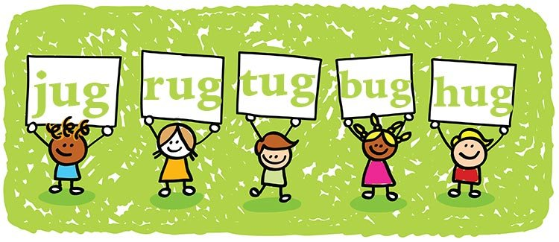
RHYME
Lesson 6 | Grades 3-6

Slide 2
Free Write
Do: Write about anything on your mind.
Do: Focus on writing for the entire five minutes.
Do: Keep your pen or pencil moving for the whole five minutes.
Don’t: Worry about conventions like spelling or punctuation.

Slide 3
BRAINSTORM
In your journal, write as many words that rhyme with “top” as you can in 30 seconds.
*Remember: rhyming words don’t have to be only one syllable. For example, “hip-hop” rhymes with “top.”
Ready… set… GO!

Slide 4
ACTIVITY
Rhymes occur when words at the end of two or more lines in a song share the same or a similar sound.
An exact rhyme has the same ending sound.
Like “last,” “past,” and “fast.”
An approximate rhyme sounds like a rhyme depending on how the artist sings the words.
Like “age,” “fade,” and “play.”

Slide 5
ACTIVITY
A rhyme scheme describes the pattern of rhyming words at the end of lines in a song.
To identify the rhyme scheme:
Use A for the first line.
For any other lines that rhyme with it, also label A.
If a line does not rhyme with A, label it B.

Slide 6
ACTIVITY
Let’s practice using the Rhyming Worksheet.
Identify the rhyme schemes of the song excerpts by placing A or B in the blanks.
Circle words that are exact rhymes.
Underline words that are approximate rhymes.

Slide 7
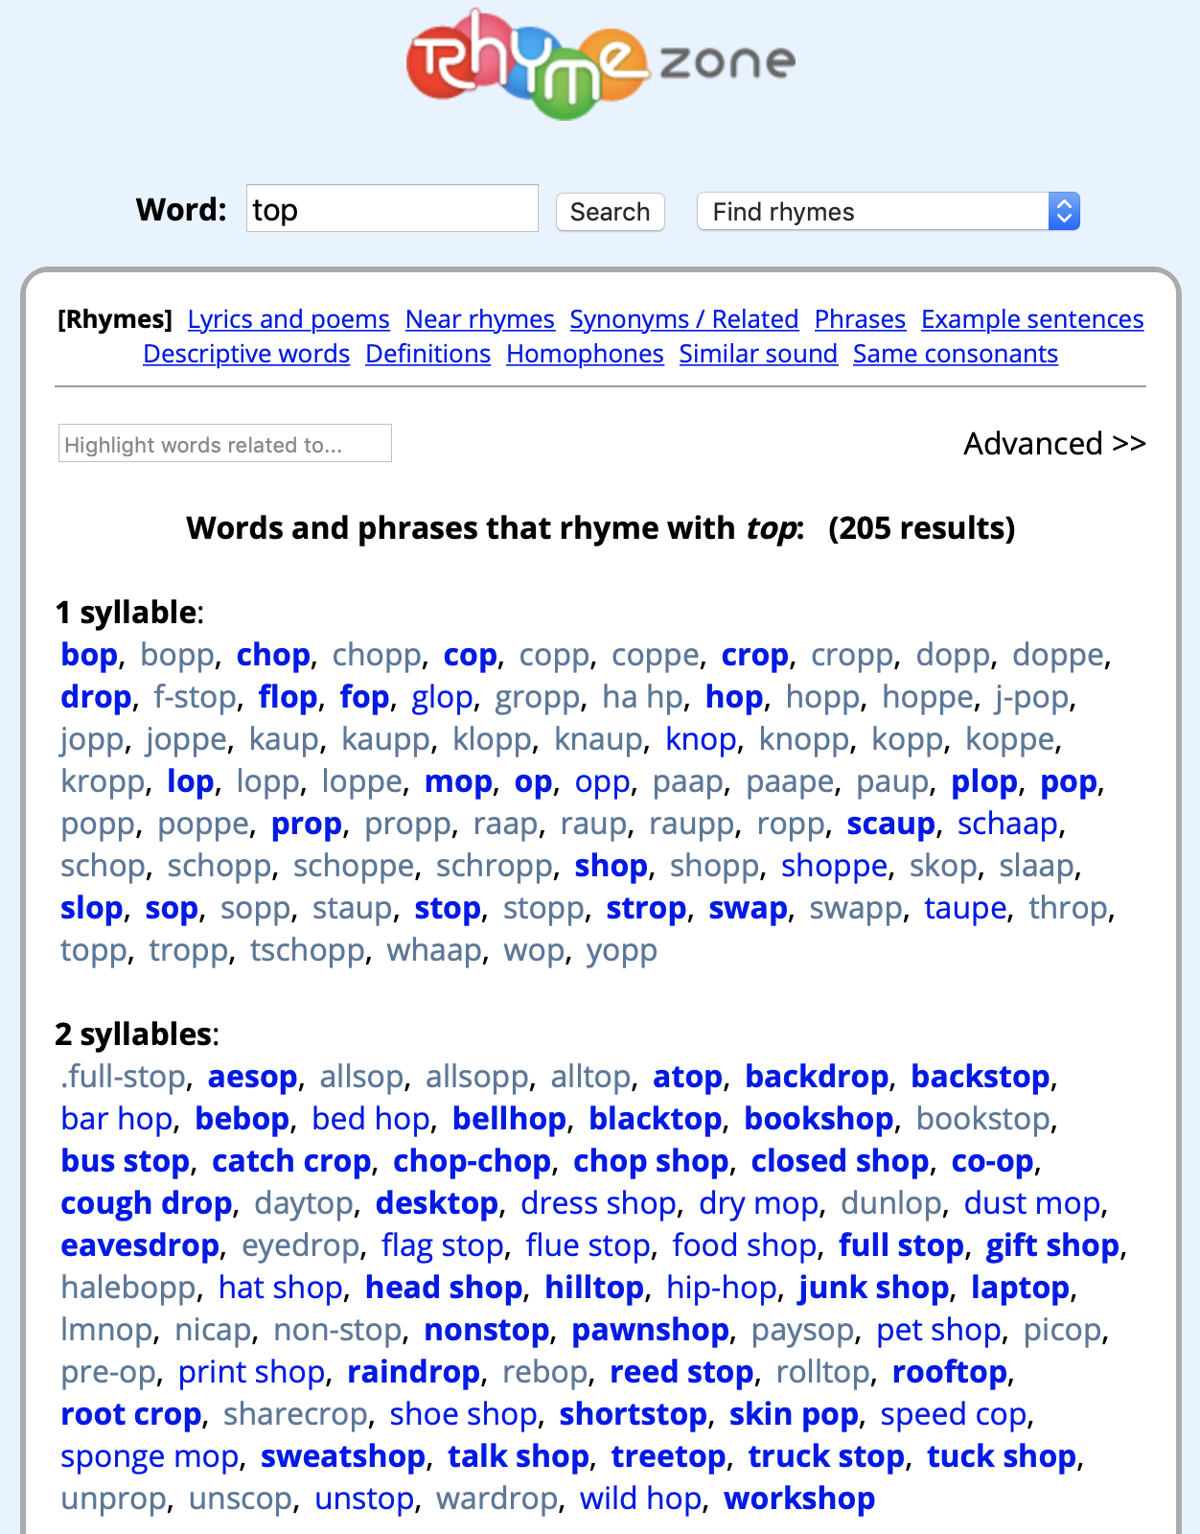
For help with rhyming, try:
Websites such as rhymezone.com and rhymer.com
A thesaurus, either on the Internet or in the library

Slide 8
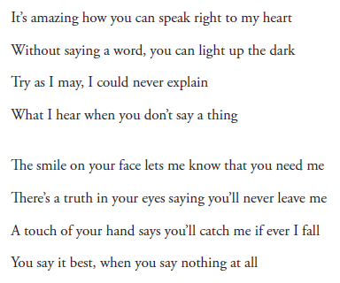
ACTIVITY
Click here for the song.

Slide 9
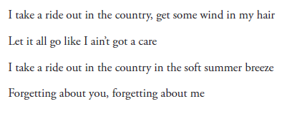
ACTIVITY
Click here for the song.

Slide 10
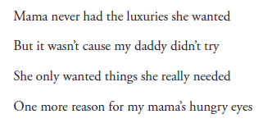
ACTIVITY
Click here for the song.

Slide 11
ACTIVITY
Click here for the song.

Slide 12
HOMEWork
Try writing part or all of a song that uses what you have learned about rhyming.
To get inspired, look back at what you have written so far in your journal.
Remember:
Pick words that fit what you want to say, not just words that rhyme.
You can use websites to help you find rhyming words.
What you write could be part of your final song or it could just be for practice.

