Slide 1
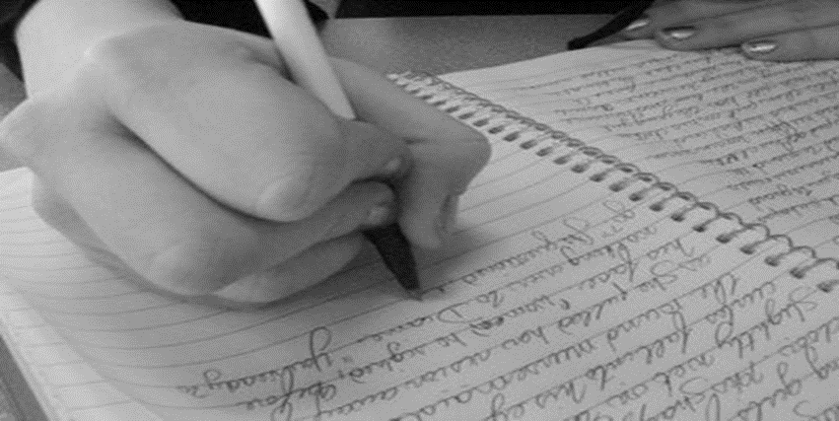
FOCUSED LYRIC-WRITING
Lesson 8 | Grades 3-6

Slide 2
FREE WRITE
Do: Write about anything on your mind.
Do: Focus on writing for the entire five minutes.
Do: Keep your pen or pencil moving for the whole five minutes.
Don’t: Worry about conventions like spelling or punctuation.

Slide 3
BRAINSTORM
For the next five minutes, look through your journal and underline anything that you are proud of or anything that you think you might want to use in your final song.
Ready… set… GO!

Slide 4
Let’s review!
Parts of a song
A song must have a title, verses, a chorus and a hook.
Some songs have a bridge.

Slide 5
Let’s review!
Title and hook
In most songs, the title appears at least once in the chorus.
The title is often the hook, the catchy phrase that makes the song easy to remember.

Slide 6
Let’s review!
Subject and Theme
The subject is the song’s topic.
The theme is the message.

Slide 7
Let’s review!
Rhythm and syllables
Each line of the verse should have about the same number of syllables.
Each line of the chorus should have about the same number of syllables.

Slide 8
Let’s review!
Rhyme
Most songs follow a rhyme scheme.
Rhymes can be exact or approximate.

Slide 9
Let’s review!
Sensory details and images
Lyrics paint mental pictures to communicate their theme and convey emotions.

Slide 10
Songwriters draw inspiration from many different sources, including other songs and songwriters.
However, if professional songwriters steal all or part of someone else’s song and sell it as their own work, this is called plagiarism , and it is illegal.
It is never OK to use a song or part of a song written by someone else and claim it as your own work.

Slide 11
Let’s Write a song!
Review the Songwriting Checklist.
Remember:
The content of the song is most important.
Songs should follow a standard structure.
Attempt to rhyme so your song is catchy and memorable.
You may use the Songwriting Template to write your song. If you decide to write a blues song, use the Blues Song Template.

Slide 12
HOMEWORK
If your song is not finished, you should complete it before the next lesson.
You will be sharing your song with a partner during the next lesson.
If you have finished your chorus and verses, you can try writing extra verses for homework. Or, you could try writing another song!

