Slide 1
REVISE
Lesson 9 | Grades 3-6

Slide 2
FREE WRITE
Do: Write about anything on your mind.
Do: Focus on writing for the entire five minutes.
Do: Keep your pen or pencil moving for the whole five minutes.
Don’t: Worry about conventions like spelling or punctuation.

Slide 3
BRAINSTORM
Songwriters use similes and metaphors to create stronger images.
Work with a partner to create as many similes and metaphors as you can in two minutes.
Ready… set… GO!

Slide 4
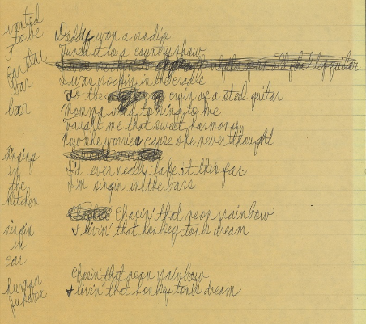
“Chasin’ That Neon Rainbow”
Written by Alan Jackson and Jim McBride
Like any style of writing, songwriting requires revision to make the song the best it can be.
To revise lyrics, songwriters may do something as simple as swapping out a few words, or they could rewrite a whole part of their song!

Slide 5
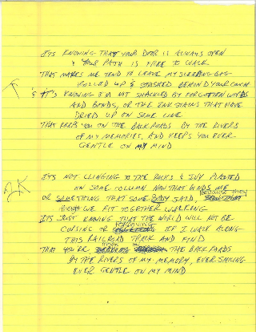
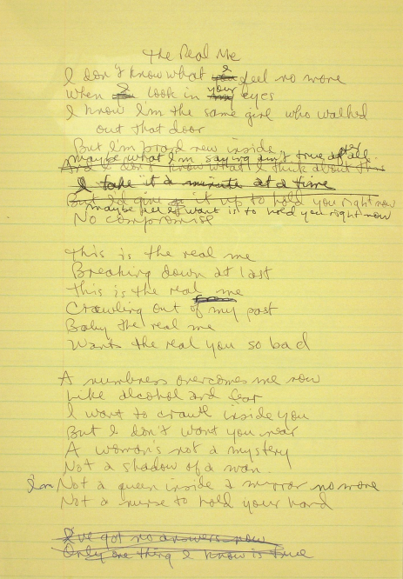
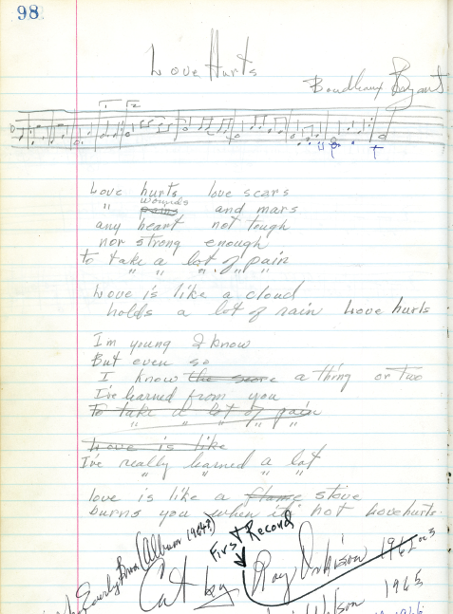
“Gentle on My Mind”
Written by John Hartford
“The Real Me”
Written by Rosanne Cash
“Love Hurts”
Written by Boudleaux Bryant

Slide 6
things to remember
for the workshop
Not all students’ songs will be arranged and performed by the professional.
This is a co-writing experience, so the songwriter may change something to make the words fit better with the music.
It is not uncommon for lyrics to be set to a variety of musical styles. Artists sometimes record cover songs , arranging the same lyrics to fit different musical genres.

Slide 7
Partner revision
Worksheet
The objective offer constructive feedback that will improve your partner’s work.

Slide 8
How to prepare your lyrics
The typed formatting should be:
12 point font, 1.5 spaced
Left justified
Chorus: indented once
Bridge: indented twice
Each set of lyrics should contain the following header information:
Student Name:
Teacher Name:
School Name:
Grade Level:
Date:
You can also make a note to the professional songwriter at the bottom of your lyric sheet to describe how you would like your song to sound.

Slide 9
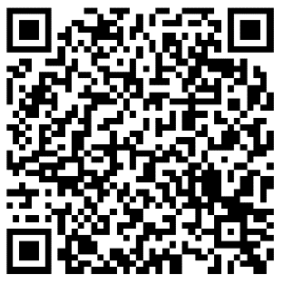
Next in Lesson 10:
Student REFLECTION and
Careers in Songwriting
Reflect on the lyric-writing process by completing the online Student Reflection.
Scan the QR code
Or visit: www.surveymonkey.com/r/WordsMusicStudent

