Slide 1
Subject and Theme
Lesson 4 | Grades 7-12

Slide 2
FREE WRITE
Do: Write about anything on your mind.
Do: Focus on writing for the entire five minutes.
Do: Keep your pen or pencil moving for the whole five minutes.
Don’t: Worry about conventions like spelling or punctuation.

Slide 3
BRAINSTORM
A popular song is one that has been heard by millions of people on the radio, Internet or television.
In your journal, write down the titles of as many popular songs as you can think of in one minute.
Ready… set… GO!

Slide 4
activity
A song’s subject is the main topic.
A song’s theme is the message the songwriter is trying to communicate about the subject.

Slide 5
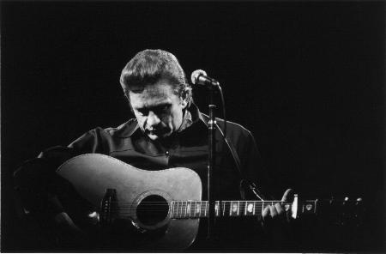
LISTEN
“Man in Black”
Written and performed by Johnny Cash
Discuss:
What is the subject and what is the theme?
What evidence from the song supports your position about the theme?
Click here for the song.

Slide 6
Discuss
In “Man in Black,” what is the subject and what is the theme?
What evidence from the song supports your position about the theme?
What can you infer from the lyrics about Johnny Cash’s views toward helping the poor and needy?
What evidence from the song makes you think so?

Slide 7
Discuss
Is what Johnny Cash expresses a personal or political viewpoint— or is there a difference between the two? Why or why not?
Is Johnny Cash contrasting his own choices with those of other people in society? Who?
What evidence from the song makes you think so?
How is this song like or unlike other songs you have studied up to this point?

Slide 8
Discuss
Which popular songs today have a strong social message?
Should songwriters think about the messages of their songs? Why or why not?
What opinions do you have about the kinds of messages that are popular in the music you listen to?

Slide 9
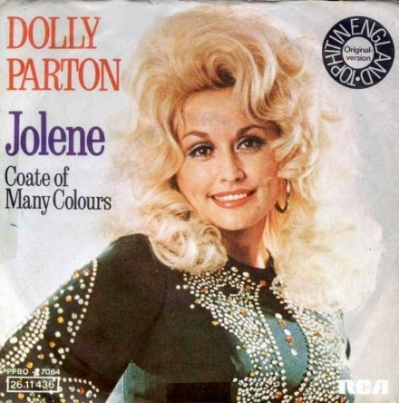
LISTEN
“Jolene”
Written and performed by Dolly Parton
Answer in your journal:
What is the subject?
What is the theme? What is your evidence?
Click here for the song.

Slide 11
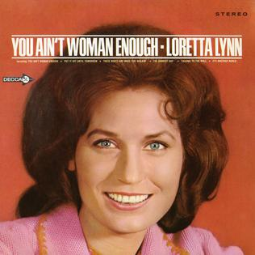
LISTEN
“You Ain’t Woman Enough”
Written and performed by Loretta Lynn
Answer in your journal:
What is the subject?
What is the theme? What is your evidence?
Click here for the song.

Slide 13
Point of View
The perspective of the singer is called the point of view .
First Person
Lyrics express personal sentiments in a state of inward expression.
Example:
“Man in Black”
Second Person
Lyrics address statements to someone else.
Example:
“Jolene” and
“You Ain’t Woman Enough”
Third Person
Lyrics are a narrator telling a story.
Can you think of any examples?

Slide 14
Reflect on the following in your journal.
Think about the songs that you like to listen to.
What are the common subjects?
What are the common themes?
What kinds of themes would you like to include in your songwriting?
In which point of view would you want to express them?

Slide 15
Homework
Journal Entry
Listen to one of your favorite songs. Write one to three sentences about how the songwriter communicates the subject.
Pick one of these two prompts:
Review your previous writings and select a subject to write more about. The writing does not have to be in the form of a song. Include a title that reflects the subject of whatever you write.
Pick a song that has a strong message and write a song with an opposing message.

