Slide 1
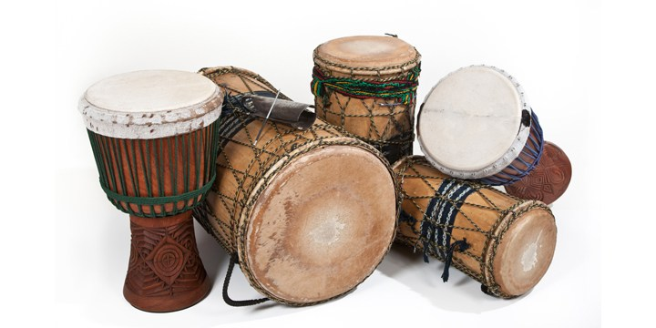
RHYTHM AND SYLLABLES
Lesson 5 | Grades 7-12

Slide 2
FREE WRITE
Do: Write about anything on your mind.
Do: Focus on writing for the entire five minutes.
Do: Keep your pen or pencil moving for the whole five minutes.
Don’t: Worry about conventions like spelling or punctuation.

Slide 3
BRAINSTORM
In your journal, spend one minute defining rhythm and naming places where you hear rhythm.
Ready… set… GO!

Slide 4
ACTIVITY
Words + Music = a Song!
For lyrics to fit well with music, songwriters
need to learn about rhythm and syllables.
Rhythm is a pattern of sounds and silences.
Syllables are the parts that a word is naturally divided
into when it is pronounced.

Slide 5
Compare the lyrics below.
Does something sound wrong?
"The Star-Spangled Banner"
And the rocket’s red glare
The bombs bursting in air
Gave proof through the night
That our flag was still there
And the rocket’s red glare
The bombs exploding all over the place
Gave proof through the night
That our flag was still there
VS.

Slide 6
Compare the lyrics below.
Does something sound wrong?
“We Will Rock You”
We will, we will rock you
We will, we will rock you
VS.
We will, we will rock you
We will, we will beat you really bad

Slide 7
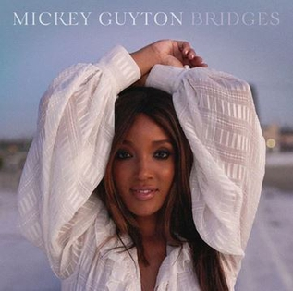
LISTEN
“Bridges”
Written by Victoria Banks / Emily Doty /
Mickey Guyton / Karen Kosowski
Click here for the song.

Slide 8
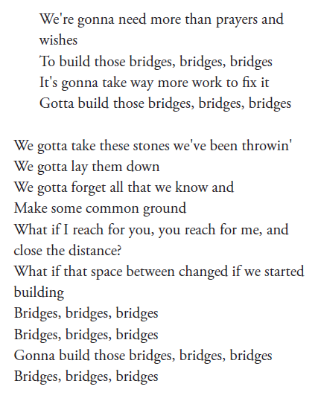
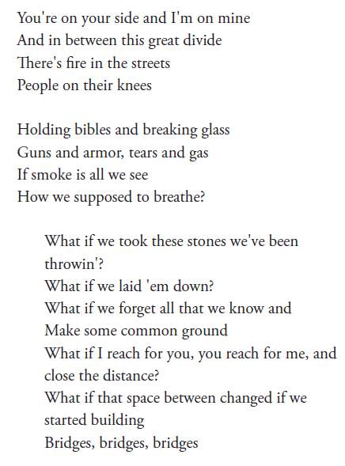
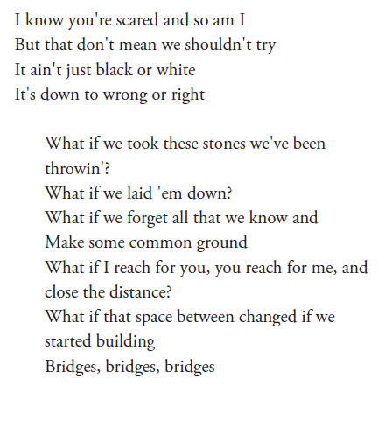

Slide 9
DISCUSSION
Count the syllables for the first verse and write the total at the end of each line.
Count the syllables for the remainder of the song.
Compare the second and third verse to the first verse. Underline or highlight any words that slightly change the rhythm and add more syllables.
What do you notice about the pattern of syllables?

Slide 10
Homework
Chose three songs to analyze.
In your journal, copy the first verse and the chorus of each song. Number the lines, and then count and write down the number of syllables in each line. For example:

Slide 11
Homework
Chose three songs to analyze.
From this exercise, what did you learn about the kinds of syllable patterns you like or dislike?
Write a verse and chorus that uses each of the three patterns you discovered. This writing (and all your writing for this unit) could become part of your final song or you could just use it as practice.

