Slide 1
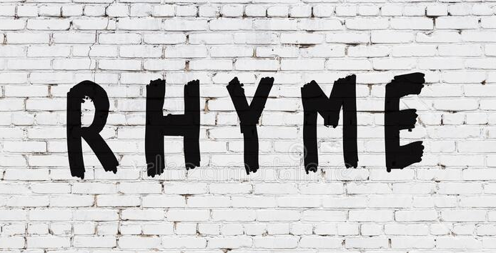
RHYME
Lesson 6 | Grades 7-12

Slide 2
Free Write
Do: Write about anything on your mind.
Do: Focus on writing for the entire five minutes.
Do: Keep your pen or pencil moving for the whole five minutes.
Don’t: Worry about conventions like spelling or punctuation.

Slide 3
BRAINSTORM
In your journal, write as many words that rhyme with “top” as you can in 30 seconds.
*Remember: rhyming words don’t have to be only one syllable. For example, “hip-hop” rhymes with “top.”
Ready… set… GO!

Slide 4
ACTIVITY
Rhymes occur when words at the end of two or more lines in a song share the same or a similar sound.
An exact rhyme has the same ending sound.
Like “last,” “past,” and “fast.”
An approximate rhyme sounds like a rhyme depending on how the artist sings the words.
Like “age,” “fade,” and “play.”

Slide 5
ACTIVITY
A rhyme scheme describes the pattern of rhyming words at the end of lines in a song.
To identify the rhyme scheme:
Use A for the first line.
For any other lines that rhyme with it, also label A.
If a line does not rhyme with A, label it B.

Slide 6
LISTEN
“I Hope You Dance”
Written by Mark D. Sanders
and Lee Ann Womack
Performed by Lee Ann Womack
Pay attention to how Womack’s singing emphasizes the rhyme scheme.
What is the rhyme scheme for “I Hope You Dance”?
Click here for the song.

Slide 8
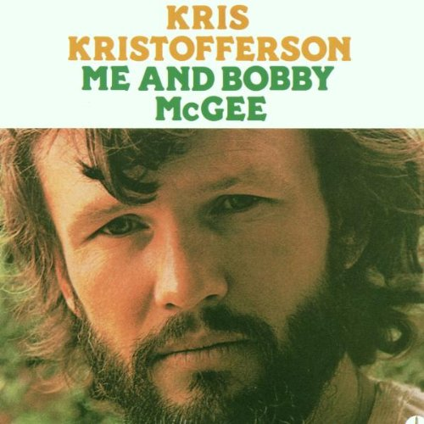
LISTEN
“Me and Bobby McGee”
Written by Kris Kristofferson and Fred Foster
Performed by Kris Kristofferson
Pay attention to how the singing emphasizes the rhyme scheme.
Determine the rhyme scheme.
Make notes of approximate rhymes.
Click here for the song
(performed by
Kris Kristopherson)
Click here for the song
(performed by
Janis Joplin)

Slide 9
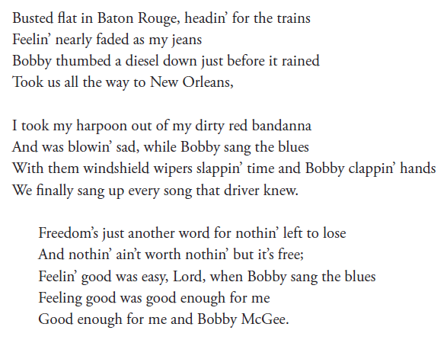
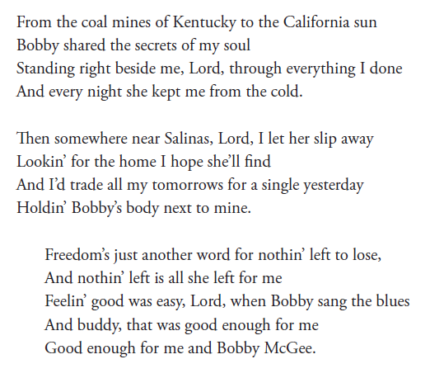

Slide 10
For help with rhyming, try:
Websites such as rhymezone.com and rhymer.com
A thesaurus, either on the Internet or in the library.
A rhyming dictionary (can be found in many libraries).

Slide 11
ACTIVITY
Write four lines with one of these rhyme schemes:
AABA
or
ABAB

Slide 12
HOMEWork
Rhyme Scheme
Pick two songs with rhyming lyrics. Locate the lyrics.
In your journal, write down the rhyme scheme for each song. Are the rhyme schemes the same or different? Explain.
Write part or all of a song that uses what you have learned about rhyming. To get inspired, look back at your journal. Remember rhymes can be exact or approximate. What you write in this assignment could be part of your final song, or it could just be for practice.

