Slide 1
CREATING STRONG IMAGES
Lesson 7 | Grades 7-12

Slide 2
FREE WRITE
Do: Write about anything on your mind.
Do: Focus on writing for the entire five minutes.
Do: Keep your pen or pencil moving for the whole five minutes.
Don’t: Worry about conventions like spelling or punctuation.

Slide 3
BRAINSTORM
In your journal, list as many details about your current surroundings as you can in 30 seconds.
Try to move past the obvious things you see and find tiny details that someone else might not notice.
Ready… set… GO!

Slide 4
BRAINSTORM
For 30 seconds, close your eyes and listen. Pay attention to every little sound.
Open your eyes and list as many sounds as you can in 30 seconds.
Repeat with smell, taste, and touch.

Slide 5
Activity
Sensory details are the individual sights, sounds, tastes, aromas, and touch sensations that allow us to take in our surroundings.
When we isolate these details and describe them in vivid and colorful language, we can stir mental pictures, or images , in our listeners’ minds.
Sensory details are the most powerful tool to create the images that move our emotions.

Slide 6
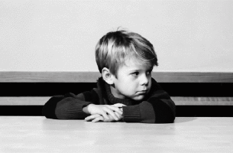
Sadness Joy Anger Fear Calm
Pick one of the words above and think of a situation when you felt that emotion.
Spend five to seven minutes writing about that experience in your journal.
Describe your experience to the group without using the actual word for the emotion.

Slide 7
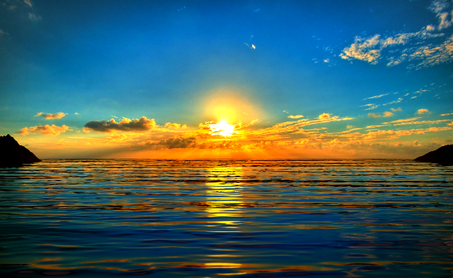
A simile can be used to create strong imagery in your lyrics. A simile is a comparison that uses “like” or “as.”
“He was as fast as a whirlwind on the basketball court.”
“The sun rose like a neon tangerine.”

Slide 8
A metaphor makes similar comparisons without using “like” or “as.”
“He was a whirlwind on the basketball court.”
“At dawn, the sun was a neon tangerine.”

Slide 9
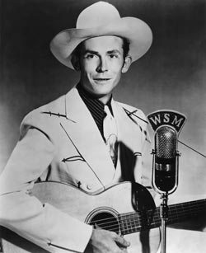
Listen
“I’m So Lonesome I Could Cry”
Written by Hank Williams
As you listen, note any images that Hank Williams creates in the song.
Click here for the song.

Slide 10
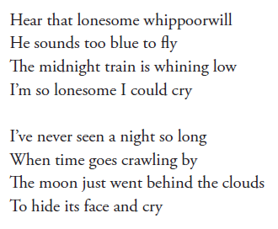
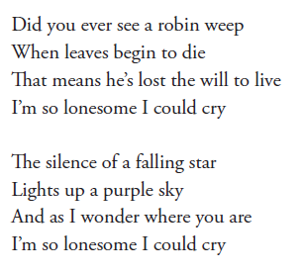

Slide 11
Discuss
How does Williams set a mood with his description of familiar images?
How do the verbs contribute to the power of the images?
Pick one image to examine more closely. What emotion or feeling is the image communicating?
What does he mean by “Did you ever see a robin weep” and “The moon just went behind the clouds to hide its face and cry”? What feeling is he creating by using these images?

Slide 12
Close your eyes ...
... and imagine a room that is familiar to you. Let your mind wander to a few different memories that have taken place in this room.
Now open your eyes and list the following details about the room in your journal. List as many details as you can, and try to move past obvious characteristics.

Slide 13
Writing Prompt
In your journal, write a paragraph or poem retelling the memory or situation from before. Use as many of the details from your list as you can.
Your writing should include at least one detail from each of your five senses plus your emotion for a total of six details.

Slide 14
What kind of images do you see when you hear these lyrics?
Sitting on the porch
Listening to the breeze
Watching the street scorch
Feel so at ease
What sensory details does the writer use?
What kind of emotion does the imagery create?

Slide 15
What is different about the images in this verse?
Sitting on the porch
On a cold and dreary day
Listening to the storm
That just won’t go away
How does the lyric relate differently to your senses than the first verse?
How is the emotion different from the first verse?
What other sense could you use to build on the images in these two verses?

Slide 16
HOMEWORK
Examine the lyrics from some of your favorite songs. Find at least one that uses images to paint a mental picture. Copy it down in your journal and highlight at least four of these images in the lyrics.
Next, pick one of the following words and think of a situation in your life when you felt that emotion:
Happiness Sadness Friendship Anger Fear Joy Worry Calm
Write a paragraph, poem, or song retelling your memory. Use all of your five senses to paint strong mental pictures.

