Slide 1
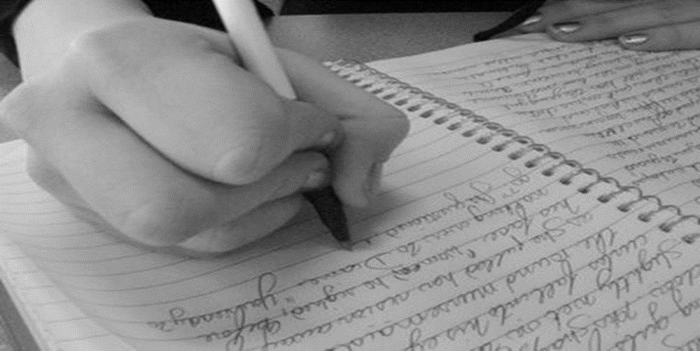
FOCUSED LYRIC-WRITING
Lesson 8 | Grades 7-12

Slide 2
FREE WRITE
Do: Write about anything on your mind.
Do: Focus on writing for the entire five minutes.
Do: Keep your pen or pencil moving for the whole five minutes.
Don’t: Worry about conventions like spelling or punctuation.

Slide 3
BRAINSTORM
Divide into groups of two and discuss what you have learned about songwriting. Talk about what you intend to include in your songs.
Ready… set… GO!

Slide 4
Let’s review!
Parts of a song
A song must have a title, verses, a chorus and a hook.
Some songs have a bridge. Some have a pre-chorus.

Slide 5
Let’s review!
Title and hook
In most songs, the title appears at least once in the chorus.
The title is often the hook, the catchy phrase that makes the song easy to remember.

Slide 6
Let’s review!
Subject and Theme
The subject is the song’s topic.
The theme is the message.

Slide 7
Let’s review!
Rhythm and syllables
Each line of the verse should have about the same number of syllables.
The message is what the song communicates about the theme.

Slide 8
Let’s review!
Rhyme
Most songs follow a rhyme scheme.
Rhymes can be exact or approximate.

Slide 9
Let’s review!
Sensory details and images
Lyrics paint mental pictures to communicate their theme and convey emotions.

Slide 10
Songwriters draw inspiration from many different sources, including other songs and songwriters.
However, if professional songwriters copy part of a song and sell it as their own work, they have committed plagiarism .
It is never OK to use a song or part of a song written by someone else and claim it as your own work!

Slide 11
Let’s write a song!
Look through your journal and read over what you have written so far.
Highlight or underline anything that you are proud of or that you want to use in your final song.
When you are finished reflecting, start working on your song.

Slide 12
Let’s write a song!
Review the Songwriting Checklist and “What if I’m Stuck?” Handout.
You may use the Songwriting Template to write your song. If you decide to write a blues song, use the Blues Song Template.
Remember:
The content of the song is most important.
Songs should follow a standard structure.
Attempt to rhyme so your song is catchy and memorable.
Songs with a uniform pattern of syllables per line are easiest to be put to music.

Slide 13
HOMEWORK
If your song is not finished, you should complete it before the next lesson.
You will be sharing your song with a partner during the next lesson.
If you have finished your chorus and verses, you can try writing extra verses for homework. Or, you could try writing another song!

